Slide 1


Modern Operating Systems
Fifth Edition
Chapter 11
Windows 11
Copyright © 2023, 2014, 2008 Pearson Education, Inc. All Rights Reserved
Notes:
If this PowerPoint presentation contains mathematical equations, you may need to check that your computer has the following installed:
1) Math Type Plugin
2) Math Player (free versions available)
3) NVDA Reader (free versions available)

Slide 2
History of M S-D O S and Windows (1 of 2)
Year | M S–D O S | M S-D O S based Windows | N T-based Windows | Modern Windows | Notes
1981 | 1 point 0 | Blank | Blank | Blank | Initial release for I B M P C
1983 | 2 point 0 | Blank | Blank | Blank | Support for P C/X T
1984 | 3 point 0 | Blank | Blank | Blank | Support for P C/A T
1990 | Blank | 3 point 0 | Blank | Blank | Ten million copies in 2 years
1991 | 5 point 0 | Blank | Blank | Blank | Added memory management
1992 | Blank | 3 point 1 | Blank | Blank | Ran only on 286 and later
1993 | Blank | Blank | N T 3.1 3 point 1 | Blank | Supported 32-bit x 86, M I P S, Alpha
1995 | Seven point 0 | 95 | N T 3.515 1 | Blank | M S-D O S embedded in Win 95 N T supports Power P C
1996 | Blank | Blank | N T 4 decimal point 0 | Blank | N T has Windows 95 look and feel
Figure 11.1 Major releases in the history of Microsoft operating systems for desktop P C s.

Slide 3
History of M S-D O S and Windows (2 of 2)
Year | M S–D O S | M S-D O S based Windows | N T-based Windows | Modern Windows | Notes
1998 | Blank | 98 | Blank | Blank
2000 | 8 point 0 | Me | 2000 | Blank | Win Me was inferior to Win 98 N T supports I A-64
2001 | Blank | Blank | X P | Blank | Replaced Win 98. N T supports x64
2006 | Blank | Blank | Vista | Blank | Vista could not supplant X P
2009 | Blank | Blank | 7 | Blank | Significantly improved upon Vista
2012 | Blank | Blank | Blank | 8 | First Modern version, supports ARM
2013 | Blank | Blank | Blank | 8.1 | Fixed complaints about Windows 8
2015–2020 | Blank | Blank | Blank | 10 | Unified O S for multiple devices Rapid releases every 6 months Reached 1.3 billion devices
2021 | Blank | Blank | Blank | 11 | Fresh new U I Broader application support Higher security baseline
Figure 11.1 Major releases in the history of Microsoft operating systems for desktop P Cs. (Continued)

Slide 4
DEC Operating Systems by Dave Cutler
Year | DEC operating system | Characteristics
1973 | R S X-11 M | 16-bit, multiuser, real-time, swapping
1978 | VAX/V M S | 32-bit, virtual memory
1987 | VAX ELAN | Real-time
1988 | PRISM/Mica | Canceled in favor of MIPS/Ultrix
Figure 11.2 DEC operating systems developed by Dave Cutler.

Slide 5
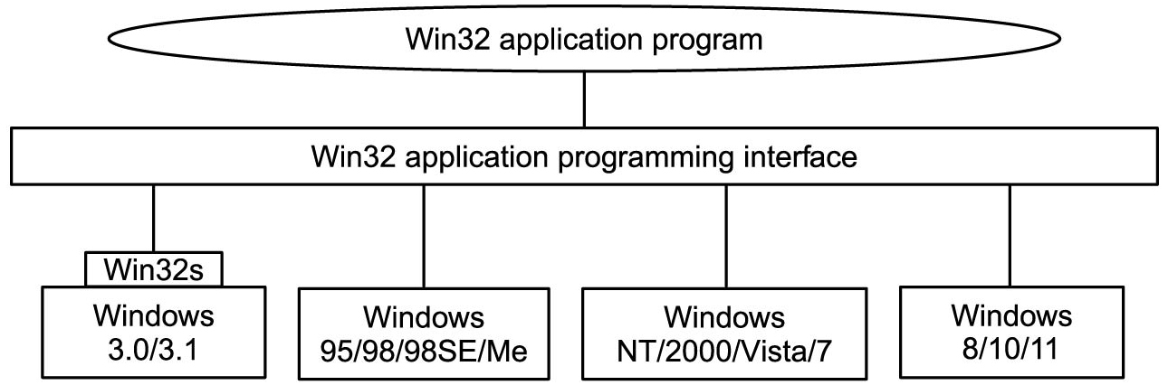
Win32
Figure 11.3 The Win 32 A P I allows programs to run on almost all versions of Windows.
Notes:
Long Description:
The figure shows three layers. Layer 1 is labeled win 32 application program, layer 2 is labeled win 32 application programming interface and layer 3 has four blocks that are connected to the second layer. The third layer has four blocks, and the first block has two parts the upper part is labeled Win 32 s and the lower part is labeled Windows 3.0 slash 3.1. The second block is labeled Windows 95 slash 98 slash 9 8 S E slash Me. The third block is labeled Windows N T slash 2000 slash Vista slash 7. The fourth block is labeled Windows 8 slash 10 slash 11.

Slide 6
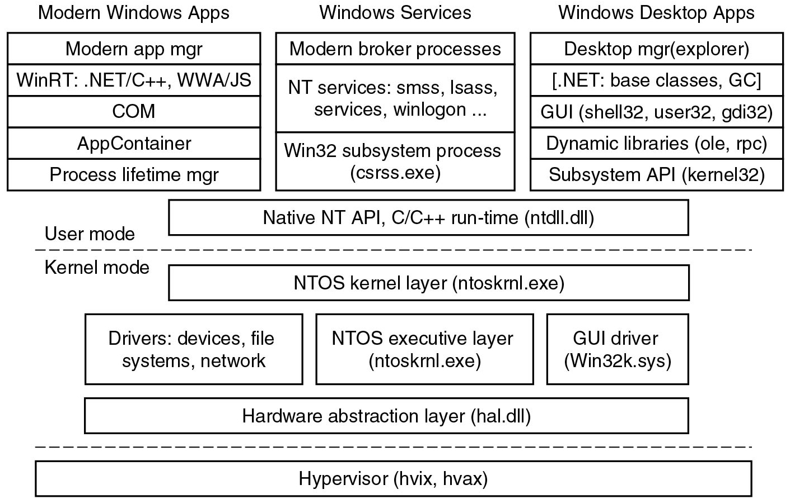
The Layers in Windows
Figure 11.4 The programming layers in modern Windows.
Notes:
Long Description:
The figure shows three layers. Layer 1 is divided into three blocks, first block is labeled Modern Windows Apps and consists of five rows which are given as follows: Modern app manager, Win R T: dot NET slash C plus plus, W W A slash J S, COM, App Container and Process lifetime manager. The second block is labeled Window s Services and consists of three rows which are given as follows: Modern broker processes, N T services: s m s s, l sass, services, win log on, Win 32 subsystem process (c s r s s dot exe). The third block is labeled Windows Desktop Apps and consists of five layers which are given as follows: Desktop manager (explorer), open square bracket dot NET: base classes, G C close square bracket, GUI (shell 32, user 32, g d i 32), Dynamic libraries (o l e, r p c) and Subsystem A P I (kernel 32). The second and third layer is labeled Native N T A P I, C slash C plus plus run-time (n t d l l. d l l), and N T O S kernel layer (ntoskrnl.exe). A dotted line is placed in between the second and third layer which is marked user mode on top of the dotted line and kernel-mode below the dotted line. The fourth layer is divided into three blocks which are given follows Drivers: devices, file systems, network, N T O S executive layer (n t o s k r n l dot exe), and GUI driver (Win 32 k dot sys). The fifth and sixth layer is labeled the Hardware abstraction layer (hal dot d l l) and Hypervisor (h vix, h vax).

Slide 7
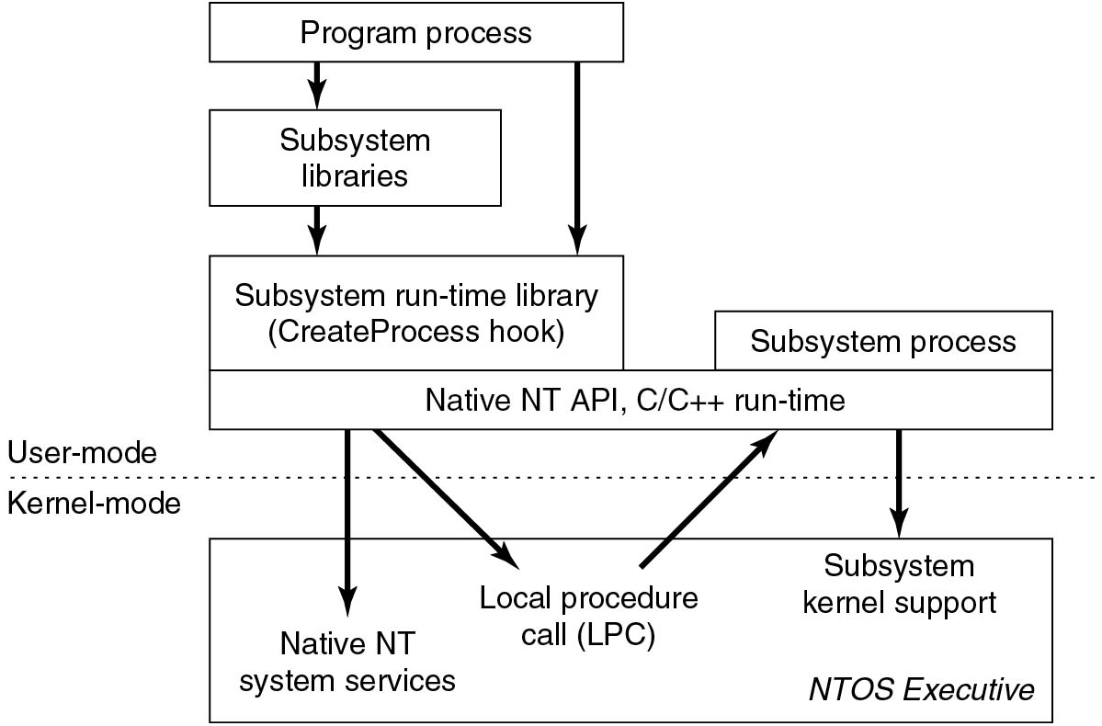
N T Subsystems
Figure 11.5 The components used to build N T subsystems.
Notes:
Long Description:
The figure starts with a block labeled program process which is pointing downward with an arrow to the next block labeled subsystem libraries. The third block is labeled Subsystem run-time library (Create Process hook). An arrow is pointing downward from the first block to the third block and from the second block to the third block. The third block is subdivided into two blocks which are labeled subsystem process and Native N T A P I, C slash C plus plus run-time. The fourth block is labeled Native N T system services, Local procedure call (L P C), subsystem kernel support, N T O S executive. A dotted line is placed in between the third and fourth block which is marked user mode on top of the dotted line and kernel mode below the dotted line.

Slide 8
Kernel Mode Objects
Object category | Examples
Synchronization | Semaphores, mutexes, events, IPC ports, I/O completion queues
I/O | Files, devices, drivers, timers
Program | Jobs, processes, threads, sections, tokens
Win 32 GUI | Desktops, application callbacks
Figure 11.6 Common categories of kernel-mode object types.

Slide 9
Examples of N T A P I Calls
N t Create Process(&Proc Handle, Access, Section Handle, Debug Port Handle, Except Port Handle, ...)
N t Create Thread(&Thread Handle, Proc Handle, Access, Thread Context, Create Suspended, ...)
N t Allocate Virtual Memory(Proc Handle, A d d r, Size, Type, Protection, ...)
N t Map View Of Section(Sect Handle, Proc Handle, A d d r, Size, Protection, ...)
N t Read Virtual Memory(Proc Handle, A d d r, Size, ...)
N t Write Virtual Memory(Proc Handle, A d d r, Size, ...)
N t Create File(&File Handle, File Name Descriptor, Access, ...)
N t Duplicate Object(s r c Proc Handle, s r c Obj Handle, d s t Proc Handle, d s t Obj Handle, ...)
Figure 11.7 Examples of native N T A P I calls that use handles to manipulate objects.

Slide 10
WIN 32 A P I
Win 32 call | Native N T A P I call
Create Process | N t Create Process
Create Thread | N t Create Thread
Suspend Thread | N t Suspend Thread
Create Semaphore | N t Create Semaphore
Read File | N t Read File
Delete File | N t Set Information File
Create File Mapping | N t Create Section
Virtual Alloc | N t Allocate Virtual Memory
Map View Of File | N t Map View Of Section
Duplicate Handle | N t Duplicate Object
Close Handle | N t Close
Figure 11.8 Examples of Win32 A P I calls and the native N T A P I calls that they wrap

Slide 11
The Registry
Hive file | Mounted name | Use
SYSTEM | H K L M\SYSTEM | O S configuration information, used by kernel
HARDWARE | H K L M\HARDWARE | In-memory hive recording hardware detected
B C D | H K L M\B C D* | Boot Configuration Database
S A M | H K L M\SAM | Local user account information
SECURITY | H K L M\SECURITY | l sass’ account and other security information
DEFAULT | H KEY USERS \.DEFAULT | Default hive for new users
N T USER.DAT | H KEY USERS \<user id> | User-specific hive, kept in home directory
SOFTWARE | H K L M\SOFTWARE | Application classes registered by COM
COMPONENTS | H K L M\COMPONENTS | Manifests and dependencies for system. components
Figure 11.9 The registry hives in Windows. H K L M is short for H KEY_LOCAL_MACHINE.

Slide 12
Win 32 Calls That Use the Registry
Win32 API function | Description
Reg Create Key Ex | Create a new registry key
Reg Delete Key | Delete a registry key
Reg Open Key Ex | Open a key to get a handle to it
Reg Enum Key Ex | Enumerate the subkeys subordinate to the key of the handle
Reg Query Value Ex | Look up the data for a value within a key
Reg Set Value Ex | Modifies data for a value within a key
Reg Flush Key | Persist any modifications on the given key to disk
Figure 11.10 Some of the Win 32 A P I calls for using the registry.

Slide 13
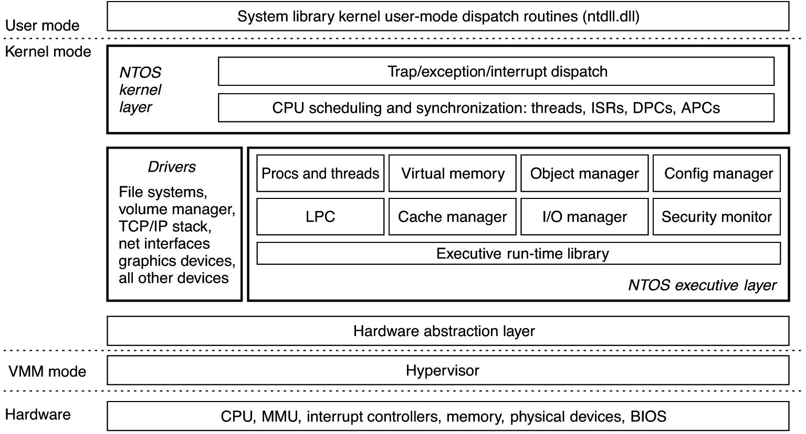
Windows System Structure
Figure 11.11 Windows kernel-mode organization.
Notes:
Long Description:
The figure consists of six layers which are given as follows: Layer 1: System library kernel user mode dispatch routines (n t d l l dot d l l). Layer 2: N T O S kernel layer, which is divided into two blocks and are given as follows trap slash exception slash interrupt dispatch and C P U scheduling and synchronization: threads, I S Rs, D P Cs, A P Cs. Layer 3 is divided into two blocks, first block is labeled Drivers, file systems, volume manager, T C P slash I P stack, net interfaces graphics devices, and all other devices. The second block is divided into four layers, first layer is subdivided into four blocks which are given as follows procs and threads, virtual memory, object manager, and config manager. The second layer is subdivided into four blocks which are labeled as follows L P C, cache manager, I bar O manager, and security monitor. The third layer is labeled executive runtime library and the fourth layer is labeled N T O S executive layer. Layer 4: Hardware abstraction layer. Layer 5: Hypervisor. Layer 6: C P U, M M U, interrupt controller, memory, physical devices, B I O S.

Slide 14
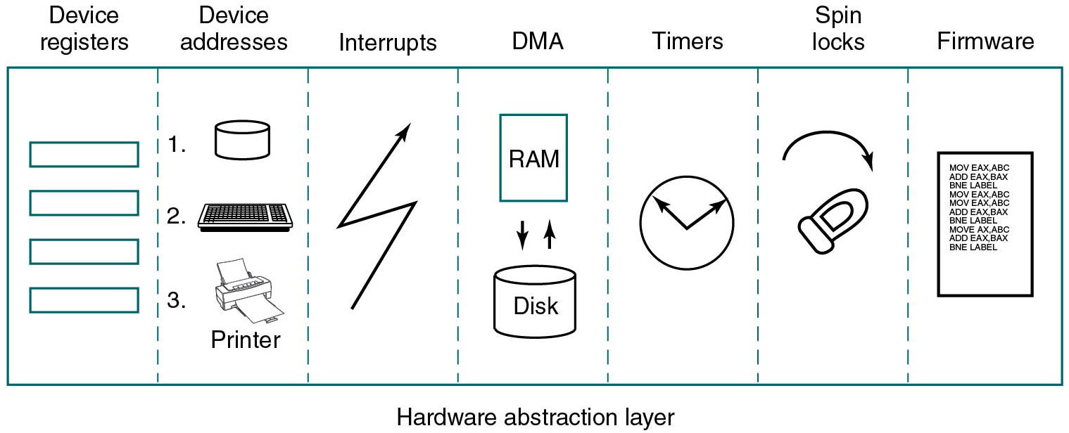
The Hardware Abstraction Layer (HAL)
Figure 11.12 Some of the hardware functions the H A L manages.
Notes:
Long Description:
The figure shows the hardware abstraction layer which is divided into seven parts, which are given as follows: devices registers, devices addresses, interrupts, D M A, timers, spinlocks, and firmware. Note: One of the devices in the device addresses is labeled printer, and the D M A includes RAM and Disk.

Slide 15
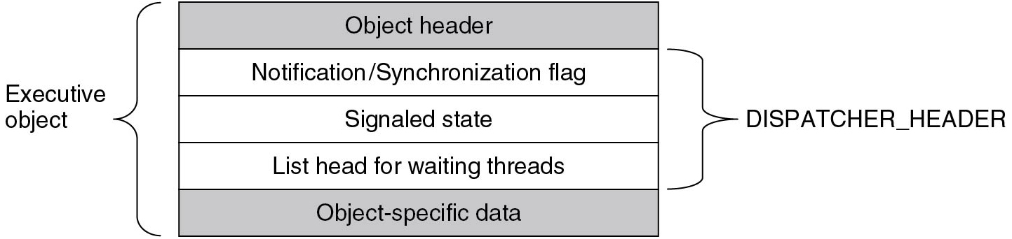
Dispatcher Objects
Figure 11.13 Dispatcher_header data structure embedded in many executive objects.
Notes:
Long Description:
The figure shows a vertical block that is divided into five layers given as follows: object header, Notification or Synchronization flag, Signaled state, List head for waiting threads, and Object-specific data. All layers are labeled executive objects and the middle three layers are labeled dispatcher header.

Slide 16
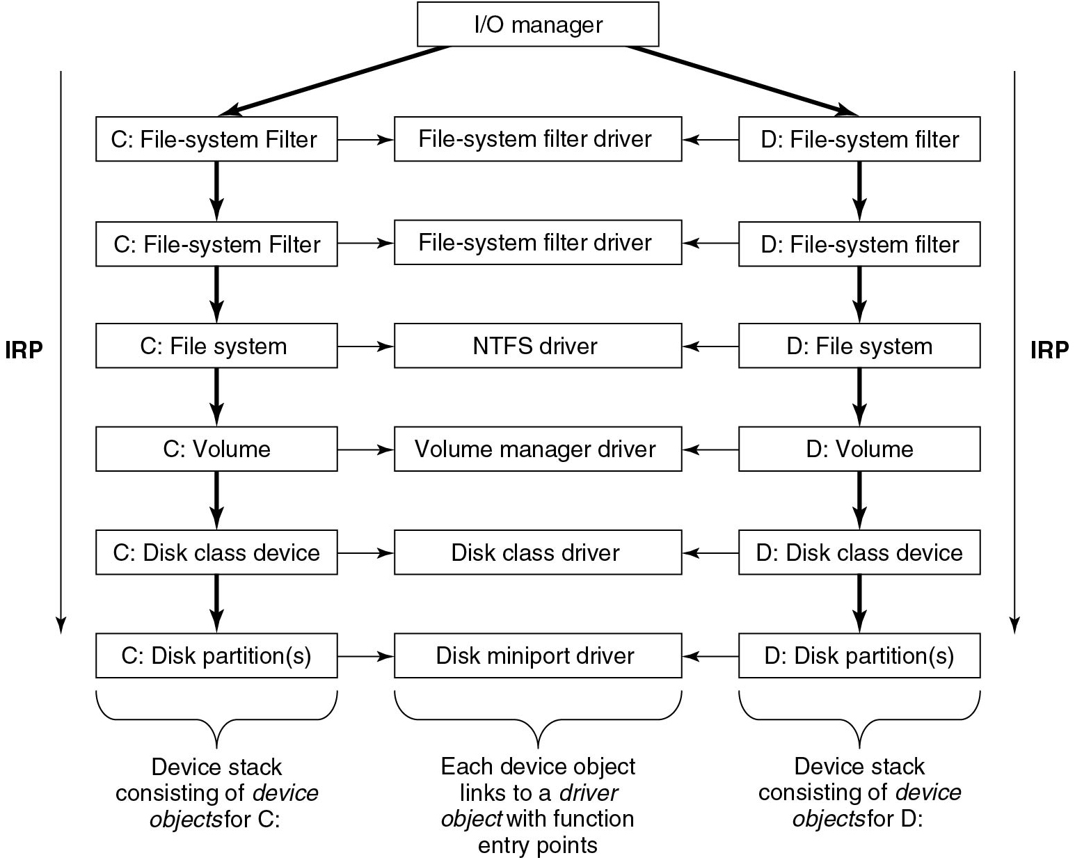
Device Stacks
Figure 11.14 Simplified depiction of device stacks for two N T F S file volumes.
Notes:
Long Description:
The block diagram is arranged in three columns and six rows. The figure starts with a bock labeled I slash O manager and two one-sided arrows are pointing downward to the first and third columns. The first column entries are given as follows C: File-system Filter, C: File-system Filter, C: File-system, C: Volume, C: Disk class device, C: Disk partition(s) with a one-sided arrow is connecting each block in a downward direction and an arrow labeled I R P which is pointing downward from top to bottom of the first column. The second column entries are given as follows File-system filter driver, File-system filter driver, N T F S driver, Volume manager driver, Disk class driver, and Disk Miniport driver with a one-sided arrow connecting each block in a downward direction. The figure starts with a bock labeled I bar O manager and two one-sided arrows are pointing downward to the first and third column. The third column entries are given as follows C: File-system Filter, C: File-system Filter, C: File-system, C: Volume, C: Disk class device, C: Disk partition(s) with a one-sided arrow is connecting each block in a downward direction and an arrow labeled I R P which is pointing downwards from top to bottom of the third column. The first column is labeled Device stack consisting of device objects for C, the second column is labeled Each device object links to a driver object with function entry points and the third column is labeled Device stack consisting of device objects for D.

Slide 17
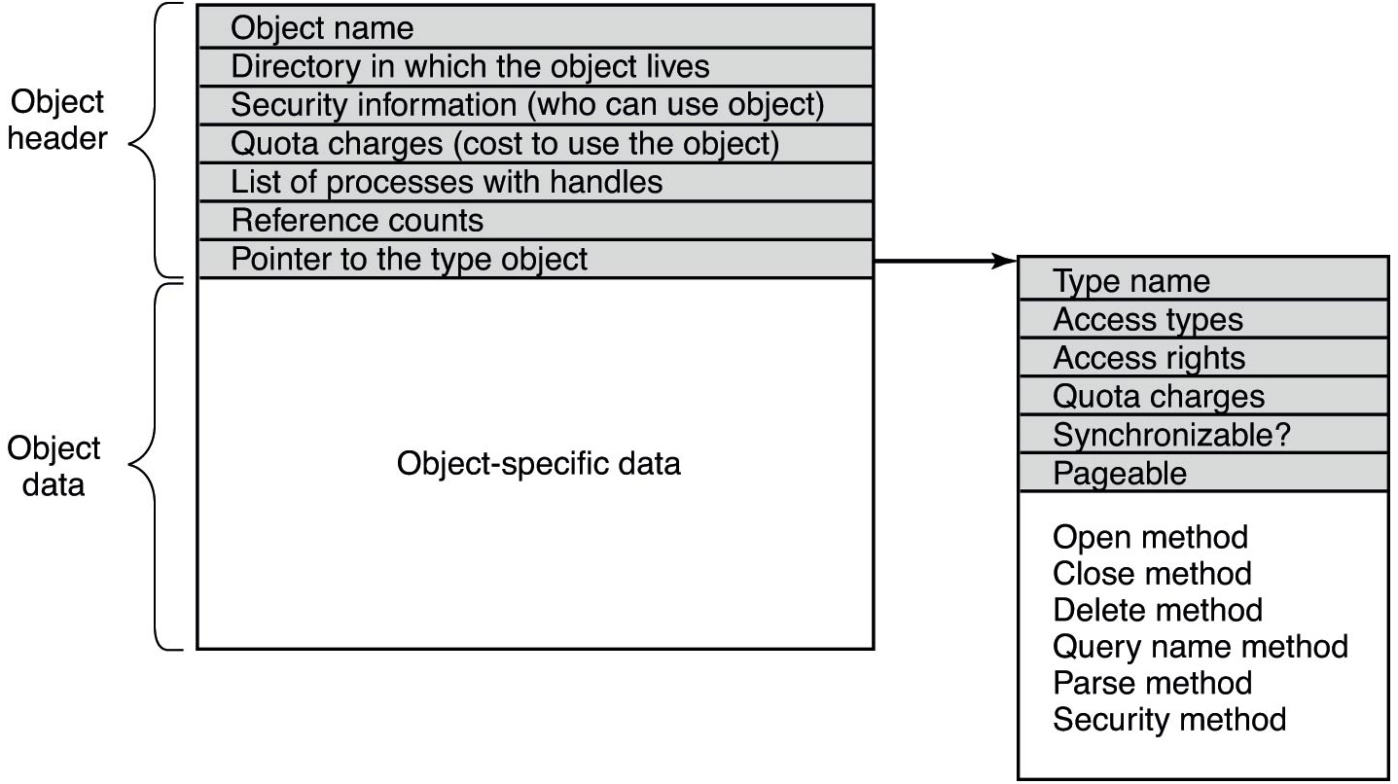
Executive objects
Figure 11.15 Structure of an executive object managed by the object manager.
Notes:
Long Description:
The figure consists of two stacks, the first stack consists of one column and 8 rows. The row entries are given as follows: Object name, Directory in which the object lives, Security information (who can use object), Quota charges (cost to use the object), List of processes with handles, Reference counts, Pointer to the type object and Object-specific data. First seven rows are shaded and marked object header and the last row is marked object data. An arrow is pointing from the seventh row to the right toward the other stack which consists of one column and seven rows. The row entries are given as follows: Type name, Access types, Access rights, Quota charges, Synchronizable, Pageable and open method, close method, Delete method, Query name method, Parse method, security method.

Slide 18
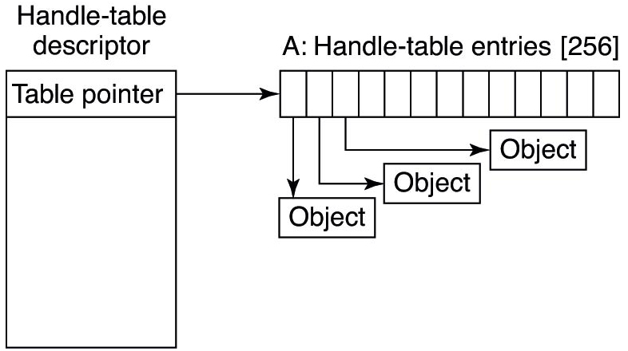
Handles (1 of 2)
Figure 11.16 Handle table data structures foRAMinimal table using a single page.
Notes:
Long Description:
The figure shows a vertical block labeled table pointer inside and handle table descriptor outside. An arrow is pointing from the block toward the right horizontal stack with 13 columns which are labeled A: Handle table entries and the first three columns are labeled with arrows as Object, Object, Object.

Slide 19
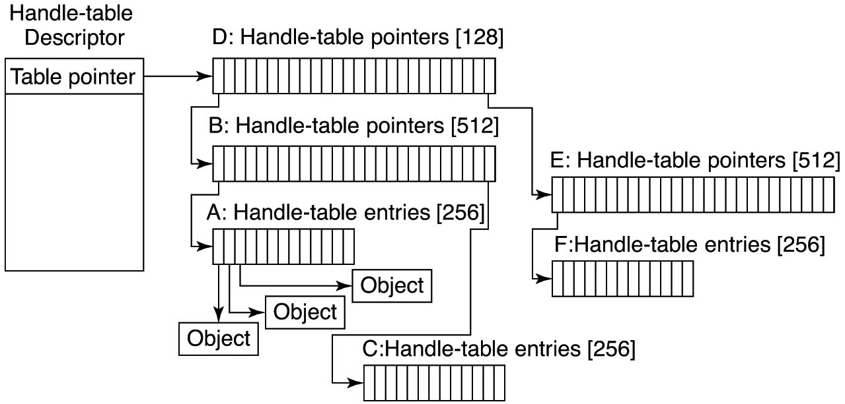
Handles (2 of 2)
Figure 11.17 Handle table structures foRAMaximal table of up to 16 million handles.
Notes:
Long Description:
The figure shows a vertical block which is labeled table pointer inside and handle table descriptor outside. An arrow is pointing from the block toward the right horizontal stack with 26 columns which are labeled D: Handle table entries open square bracket 128 close square bracket, B: Handle table entries open square bracket 512 close square bracket, E: Handle table entries open square bracket 512 close square bracket. Three horizontal stacks with 13 columns are given as follows: C: Handle table entries open square bracket 256 close square bracket, F: Handle table entries open square bracket 256 close square bracket, and A: Handle table entries open square bracket 256 close square bracket and the first three columns are labeled with arrows as Object, Object, Object

Slide 20
Object Procedures
Procedure | When called | Notes
Open | For every new handle | Rarely used
Parse | For object types that extend the namespace | Used for files and registry keys
Close | At last handle close | Clean up visible side effects
Delete | At last pointer dereference | Object is about to be deleted
Security | Get or set object’s security descriptor | Protection
Query Name | Get object’s name | Rarely used outside kernel
Figure 11.18 Object procedures supplied when specifying a new object type.

Slide 21
Directories in the Object Namespace
Directory | Contents
\GLOBAL?? | Starting place for looking up Win 32 devices like C:
\Device | All discovered I/O devices
\Driver | Objects corresponding to each loaded device driver
\Object Types | The type objects such as those listed in Fig. 11.21
\Windows | Objects for sending messages to all the Win32 GUI windows
\Base Named Objects | User-created Win 32 objects such as events, mutexes, etc.
\Sessions | Win 32 objects created in the session. Sess. 0 uses \Base Named Objects
\Arc name | Partition names discovered by the boot loader
\N L S | National Language Support objects
\File System | File-system driver objects and file system recognizer objects
\Security | Objects belonging to the security system
\Known D L Ls | Key shared libraries that are opened early and held open
Figure 11.19 Some typical directories in the object namespace.

Slide 22
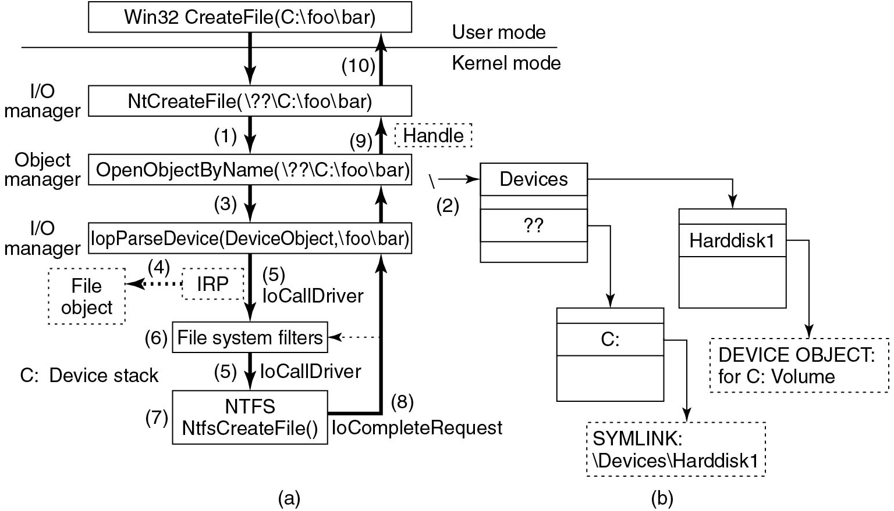
Opening a File
Figure 11.20 I/O and object manager steps for creating/opening a file and getting a handle.
Notes:
Long Description:
The figure shows two parts. Part a: Win 32 Create File(C: backward slash foo backward slash bar) block is pointing an arrow toward the N t Create File(backward slash double question mark backward slash C: backward slash foo backward slash bar) block. This block is pointing an arrow toward the Open Object By Name(backward slash double question mark backward slash C: backward slash foo backward slash bar) block and the arrow is labeled 1 and I bar O manager. This block is pointing an arrow toward the I o p Parse Device(Device Object, backward slash foo backward slash bar) block, and the arrow is labeled 3 and Object manager. This block is pointing an arrow toward the File system filters block and the arrow is labeled 5 and I o Call Driver, a dotted block which is placed near this arrow and labeled I R P and an arrow is connecting from this bock and pointed toward other dotted block labeled file object. This block is pointing an arrow toward the N T F S N t f s Create File()block and the arrow is labeled 5 and I o Call Driver. The one-sided upward arrows are connected to each block and labeled 8,9 and 10. A line is placed in between the first and second block which is marked user mode on top of the dotted line and kernel-mode below the dotted line. Part b: An arrow is pointing toward the Devices block and labeled 2. This block is pointing an arrow toward the C block and hard disk block. This block is pointing an arrow toward the SYM LINK backward slash Devices backward slash Hard disk 1 and DEVICE OBJECT: for C: Volume

Slide 23
Executive Object Types (1 of 2)
Type | Description
Process | User process
Thread | Thread within a process
Semaphore | Counting semaphore used for interprocess synchronization
Mutex | Binary semaphore used to enter a critical region
Event | Synchronization object with persistent state (signaled/not)
A L P C port | Mechanism for interprocess message passing
Timer | Object allowing a thread to sleep for a fixed time interval
Queue | Object used for completion notification on asynchronous I/O
Open file | Object associated with an open file
Access token | Security descriptor for some object
Figure 11.21 Some common executive objects types manager by the object manager.

Slide 24
Executive Object Types (2 of 2)
Type | Description
Profile | Data structure used for profiling C P U usage
Section | Object used for representing mappable files
Key | Registry key, used to attach registry to object-manager namespace
Object directory | Directory for grouping objects within the object manager
Symbolic link | Refers to another object manager object by path name
Device | I/O device object for a physical device, bus, driver, or volume instance
Device driver | Each loaded device driver has its own object
Figure 11.21 Some common executive objects types manager by the object manager.(Continued)

Slide 25
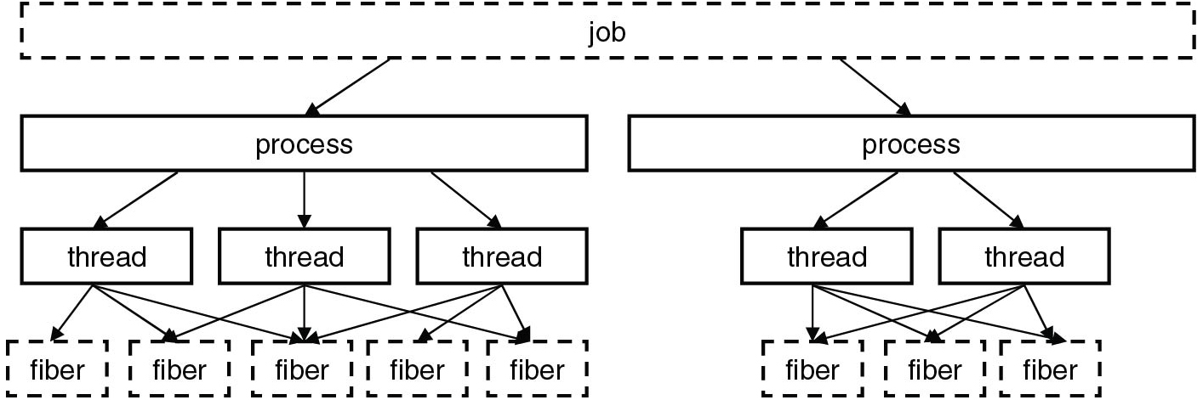
Jobs, Processes, Threads, and Fibers
Figure 11.22 The relationship between jobs, processes, threads, and Fibers.
Notes:
Long Description:
The figure shows the horizontal block labeled job. This block is pointing two arrows toward the two process blocks. One process block is pointing two arrows toward the two thread blocks. Another block is pointing three arrows toward the three-thread blocks. Each block is pointing three arrows toward the fiber blocks.

Slide 26
Concepts for C P U Management
Name | Description | Notes
Job | Collection of processes that share quotas and limits | Used in App Containers
Process | Container for holding resources | Blank
Thread | Entity scheduled by the kernel | Blank
Fiber | Lightweight thread managed entirely in user space | Rarely used
Thread pool | Task-oriented programming model | Built on top of threads
Figure 11.23 Basic concepts used for C P U and resource management.

Slide 27
Synchronization Primitives
Primitive | Kernel object | Kernel/User | Shared/Exclusive
Event | Yes | Both | N/A
Semaphore | Yes | Both | N/A
Mutex | Yes | Both | Exclusive
Critical Section | No | User-mode | Exclusive
S R W Lock | No | User-mode | Shared
Condition Variable | No | User-mode | N/A
Init Once | No | User-mode | N/A
Wait On Address | No | User-mode | N/A
E Resource | No | Kernel-mode | Shared
Fast Mutex | No | Kernel-mode | Exclusive
Push Lock | No | Kernel-mode | Shared
Cache-aware Push Lock | No | Kernel-mode | Shared
Auto-expand Push Lock | No | Kernel-mode | Shared
Figure 11.24 Summary of synchronization primitives.

Slide 28
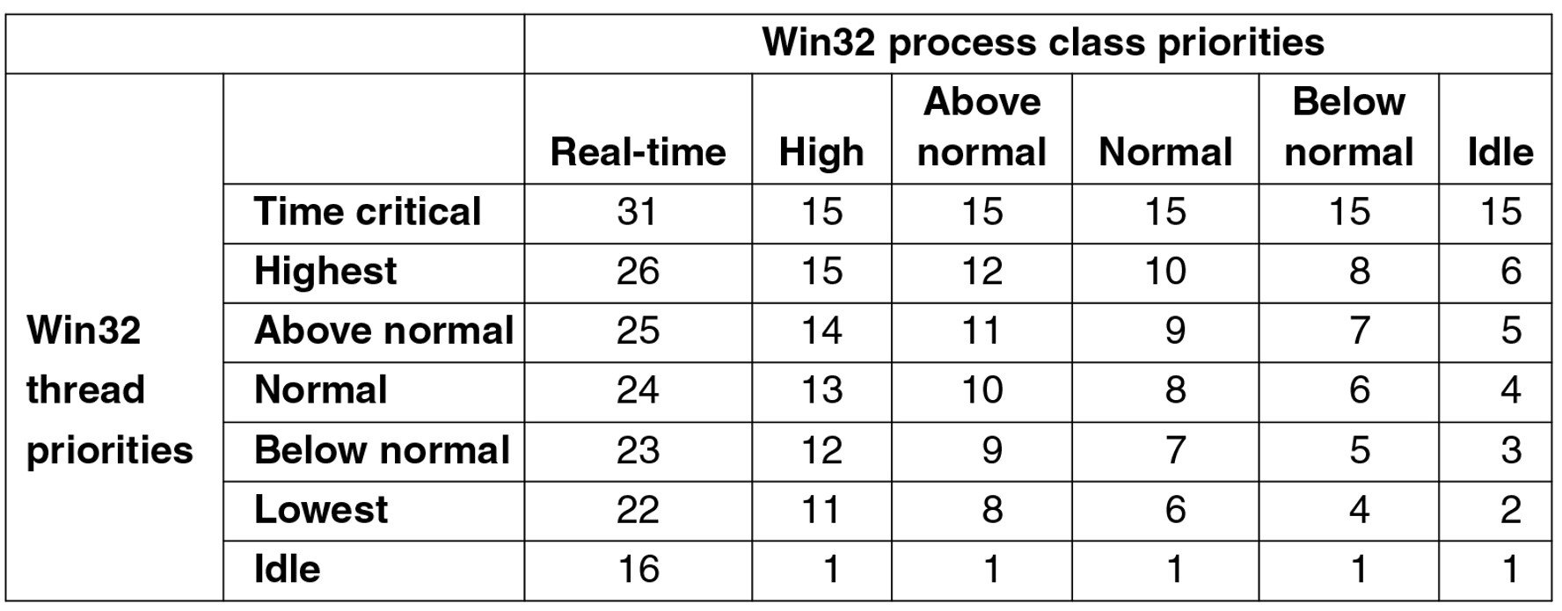
Priorities
Figure 11.25 Mapping of Win 32 priorities to Windows priorities.
Notes:
Long Description:
<html> <head> <style type="text/css"> th{ border: 1px solid black; } tr th { padding:4px; } td{ padding:4px; } </style> </head> <body> <table border="1"><tr><th rowspan="2"></th><th rowspan="2"></th><th colspan="6">Win32 process class priorities</th></tr><tr><th>Real-time</th><th>High</th><th>Above normal</th><th>Normal</th><th>Below normal</th><th>Idle</th></tr><tr><td rowspan="7">Win 32 thread priorities</td><td align="left">Time critical </td><td align="right">31 </td><td align="right">15 </td><td align="right">15 </td><td align="right">15 </td><td align="right">15 </td><td align="right">15 </td></tr><tr><td align="left">Highest </td><td align="right">26 </td><td align="right">15 </td><td align="right">12 </td><td align="right">10 </td><td align="right">8 </td><td align="right">6 </td></tr><tr><td align="left">Above normal </td><td align="right">25 </td><td align="right">14 </td><td align="right">11 </td><td align="right">9 </td><td align="right">7 </td><td align="right">5 </td></tr><tr><td align="left">Normal </td><td align="right">24 </td><td align="right">13 </td><td align="right">10 </td><td align="right">8 </td><td align="right">6 </td><td align="right">4 </td></tr><tr><td align="left">Below normal </td><td align="right">23 </td><td align="right">12 </td><td align="right">9 </td><td align="right">7</td><td align="right">5 </td><td align="right">3 </td></tr><tr><td align="left">Lowest </td><td align="right">22 </td><td align="right">11 </td><td align="right">8 </td><td align="right">6 </td><td align="right">4 </td><td align="right">2 </td></tr><tr><td align="left">Idle </td><td align="right">16 </td><td align="right">1 </td><td align="right">1</td><td align="right">1</td><td align="right">1 </td><td align="right">1</td></tr></table></body></html>

Slide 29
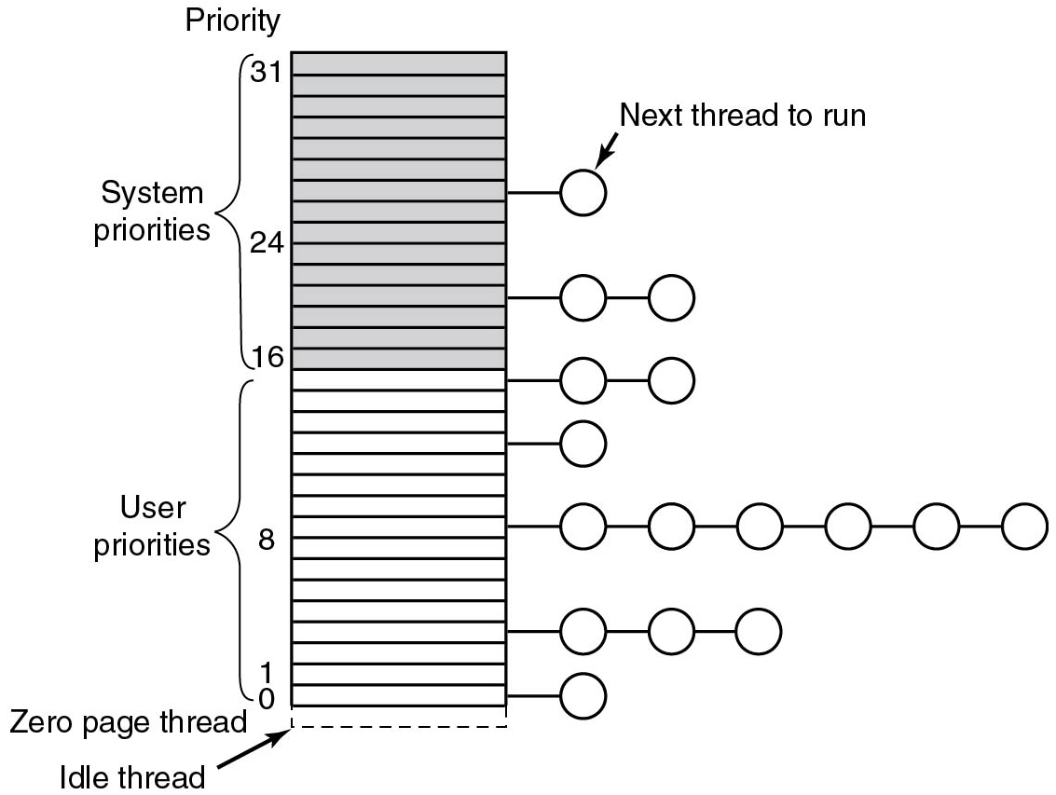
Thread priorities
Figure 11.26 Windows supports 32 priorities for threads.
Notes:
Long Description:
The figure shows the vertical stack with 32 layers. The layers from 0 to 16 are labeled user priorities and 16 to 31 are labeled system priorities. 0 is labeled Zero page thread and an arrow pointed towards 0 is labeled Idle thread. Bubbles are attached to the stack and labeled with an arrow as the next thread to run.

Slide 30
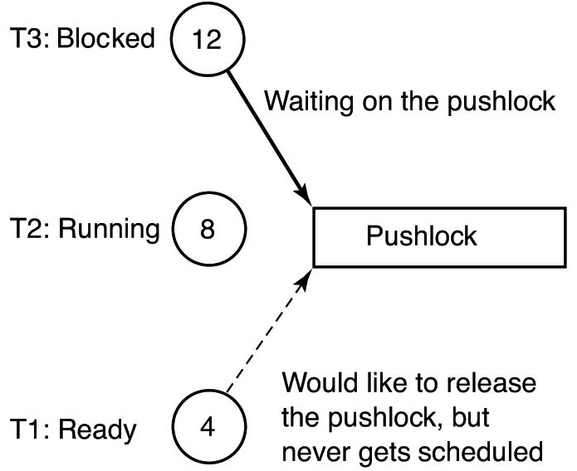
Priority Inversion
Figure 11.27 An example of priority inversion.
Notes:
Long Description:
The figure consists of a horizontal block labeled push lock. A one sided arrow is pointing toward the block from a circle which is placed above the block and labeled 12, T 3: Blocked and the arrow is labeled waiting on the push lock. Another one sided dotted arrow is pointing toward the block from a circle which is placed below the block and labeled 4 and T 1: ready and the arrow is labeled would like to release the push lock, but never get scheduled. A circle which is placed near the block and labeled 8 and T 2:running.

Slide 31
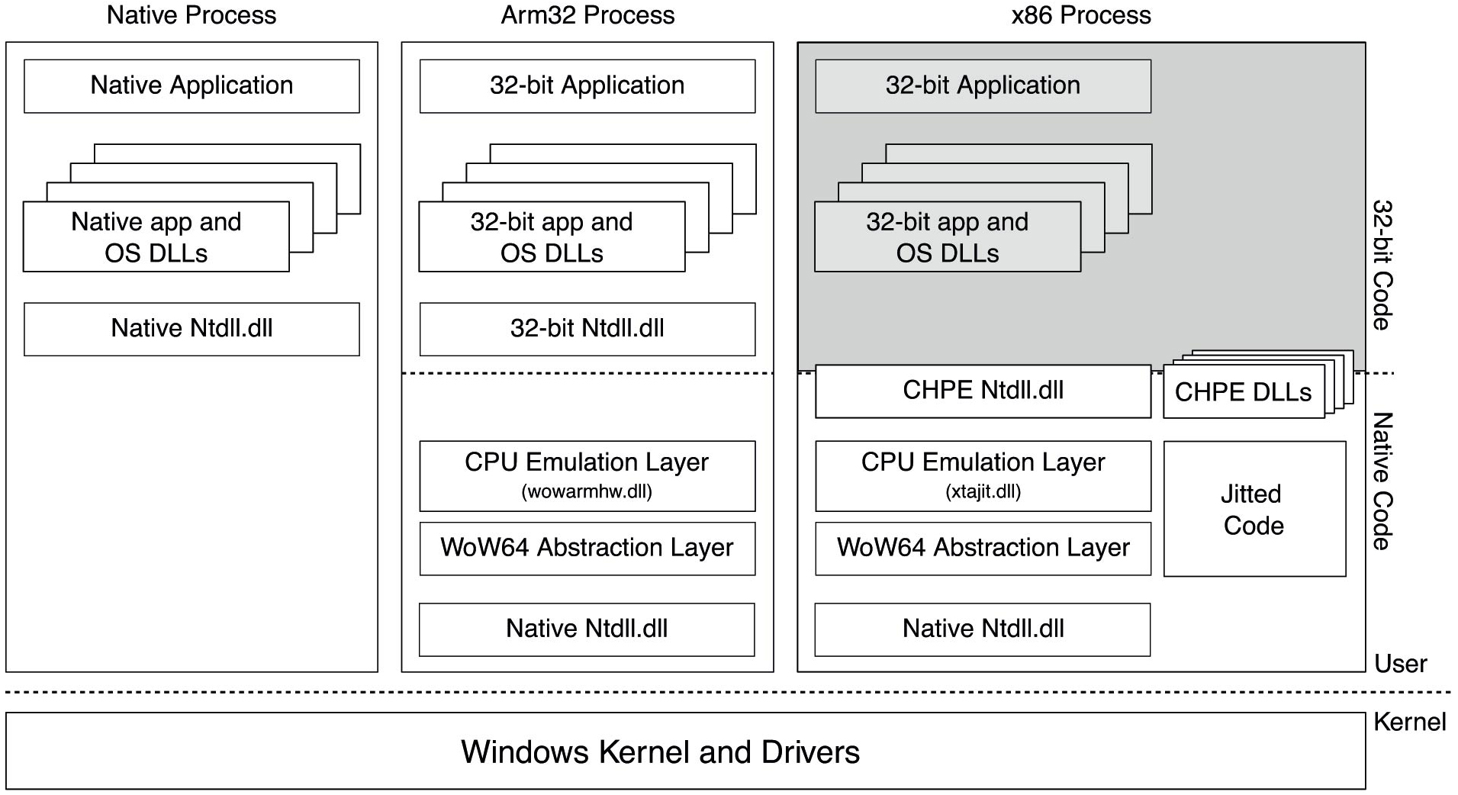
Windows on Windows
Figure 11.28 Native versus. WoW 6 4 on an arm 64 machine. Shaded areas indicate emulated code.
Notes:
Long Description:
The figure consists of three vertical blocks and one horizontal block, First block is labeled native process that contains three sub blocks which are labeled native application, native app, O S D L Ls, and native N t d l l dot d l l. The second block is labeled Arm 32 process that contains six sub blocks which are labeled 32 bit application, 32 bit app, and O S D L L s, 32 bit N t d l l dot d l l, C P U emulation layer, which is shaded, WoW 6 4 Abstraction layer, and Native N t d l l dot d l l. Shaded areas indicate emulated code. The third block is labeled x 8 6 process that contains eight sub blocks which are labeled 32 bit application, 32 bit app and O S D L L s, C H P E N t d l l dot d l l, C P U emulation layer, C H P E D L L s, jitted code, and Native N t d l l dot d l l. The horizontal block is labeled windows kernel and drivers.

Slide 32
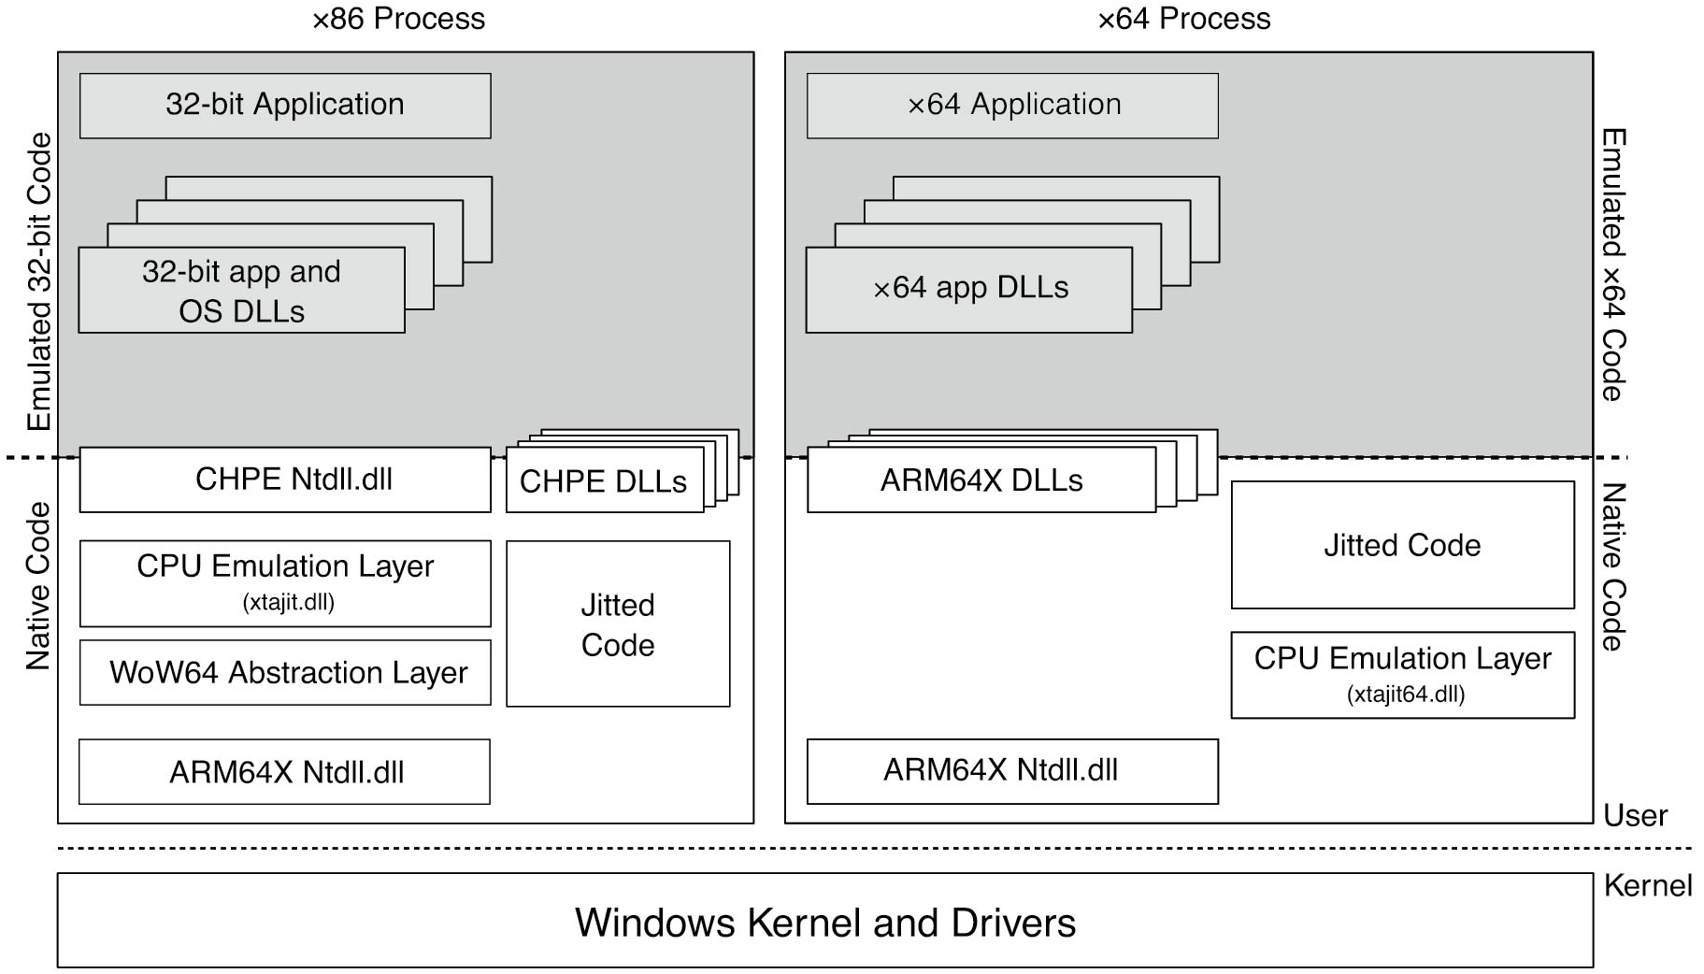
Comparison of x 86 and x 64 Emulation
Figure 11.29 Comparison of x 86 and x 64 emulation infrastructure on an arm 64 machine. Shaded areas indicate emulated code.
Notes:
Long Description:
The figure consists of two vertical blocks and one horizontal block, the first block is labeled x 86 process that contains eight sub blocks which are labeled 32 bit application, 32 bit app and O S D L Ls, C H P E N t d l l dot d l l, C P U emulation layer (x t a j i t dot d l l), C H P E D L Ls, jitted code, ARM 64 X N t d l l dot d l l, and WoW 6 4 Abstraction layer and the vertical side of the block is labeled Emulated 32 bit code and native code. The second block is labeled x 64 process that contains six sub blocks which are labeled x 6 4 application, x 64 app D L Ls, C P U emulation layer, ARM 6 4 X D L Ls, jitted code, and ARM 6 4 X N t d l l dot d l l and the vertical side of the block is labeled Emulated x 64 code and native code. The horizontal block is labeled windows kernel and drivers. The horizontal block is labeled windows kernel and drivers. The part till a dotted line above the horizontal block is labeled User and the part below the horizontal block is labeled Kernel.

Slide 33
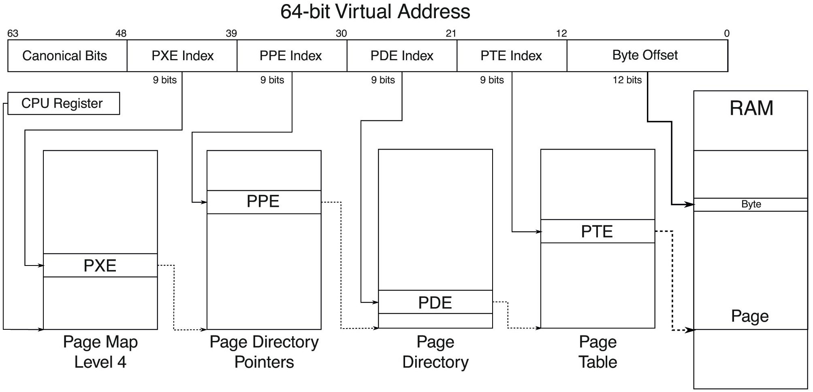
Paging
Figure 11.30 Virtual to physical address translation with a 4-level page table with 48 address bits.
Notes:
Long Description:
The figure consists of six blocks which are labeled Canonical bits, P X E index, P P E index, P D E index, P T E index, Byte offset from left to right, also these blocks define the range of Bytes 0 to 12, 12 to 21, 21 to 30, 30 to 39, 39 to 48 and 48 to 63 from right to left. The second block of 9 bits is pointing an arrow to the P X E layer of the vertical block which is labeled page map level 4 and a C P U register block is also pointed to this block. The third block of 9 bits is pointing an arrow to the P P E layer of the vertical block which is labeled page directory pointers. The fourth block of 9 bits is pointing an arrow to the P D E layer of the vertical block which is labeled page directory. The fifth block of 12 bits is pointing an arrow to the P T E layer of the vertical block, which is labeled page table. The sixth block is pointing an arrow to the RAM block.

Slide 34
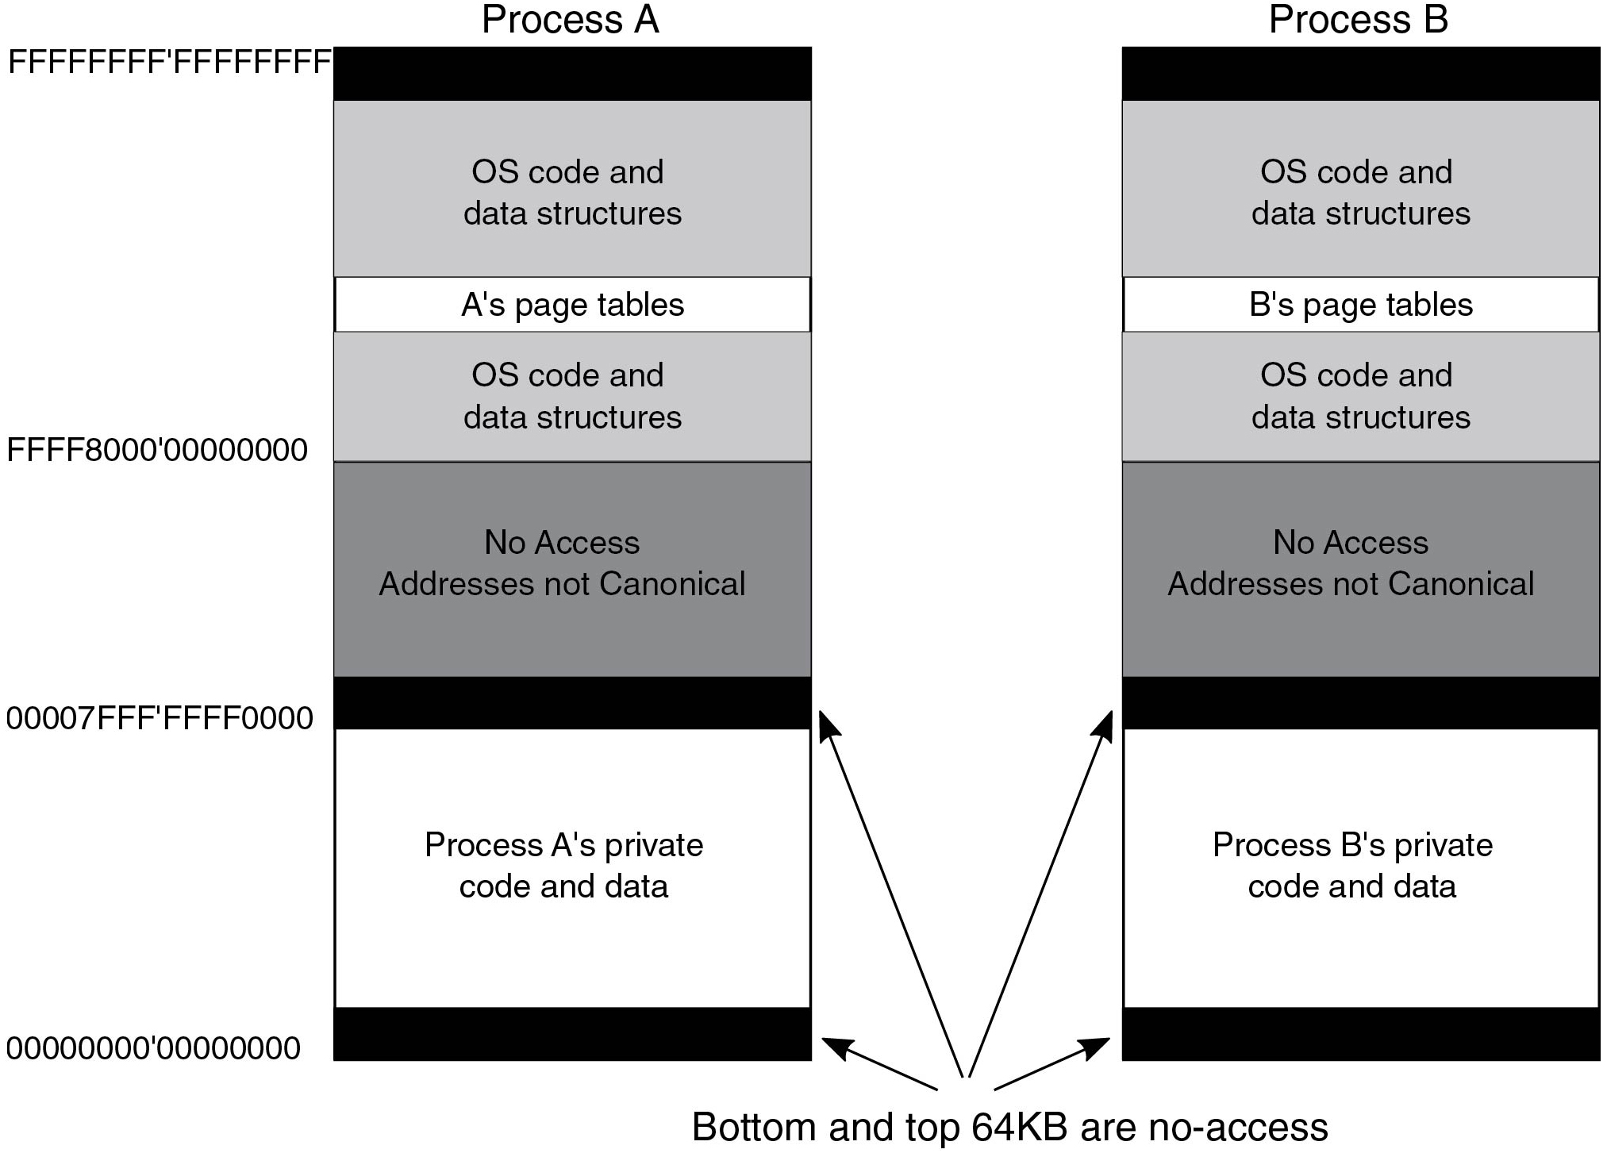
Virtual Address Space Layout
Figure 11.31 Virtual address space layout for 64-bit user processes. The white areas are private. The shaded ones are shared.
Notes:
Long Description:
The figure consists of two vertical blocks. The block labeled process A is divided into five sub-blocks, Process A's private code and data is ranging from 0 0 0 0 0 0 0 0’0 0 0 0 0 0 0 0 to 0 00 0 7 F F F’F F F F 0 0 0 0, No Access Addresses not Canonical is ranging from 0 0 0 0 7 F F F’F F F F 0 0 0 0 to F F F F 8 0 0 0’0 0 0 0 0 0 0 0, O S code and data structures, A's page tables and O S code and data structures is ranging from F F F F 8 0 0 0’0 0 0 0 0 0 0 0 to F F F F F F F F’F F F F F F F F. Another vertical block is labeled process B and is divided into five sub-blocks, Process B's private code and data, No Access Addresses not Canonical, O S code and data structures, B's page tables, and O S code and data structures. Four one-sided upward arrows are pointed to these blocks and labeled Bottom and top 64 K B are no-access.

Slide 35
Win 32 Calls for Virtual Memory
Win 32 A P I function | Description
Virtual Alloc | Reserve or commit a region
Virtual Free | Release or decommit a region
Virtual Protect | Change the read/write/execute protection on a region
Virtual Query | Inquire about the status of a region
Virtual Lock | Make a region memory resident (i.e., disable paging for it)
Virtual Unlock | Make a region pageable in the usual way
Create File Mapping | Create a file-mapping object and (optionally) assign it a name
Map View Of File | Map (part of) a file into the address space
Unmap View Of File | Remove a mapped file from the address space
Open File Mapping | Open a previously created file-mapping object
Figure 11.32 The principal Win32 A P I functions for managing virtual memory.

Slide 36
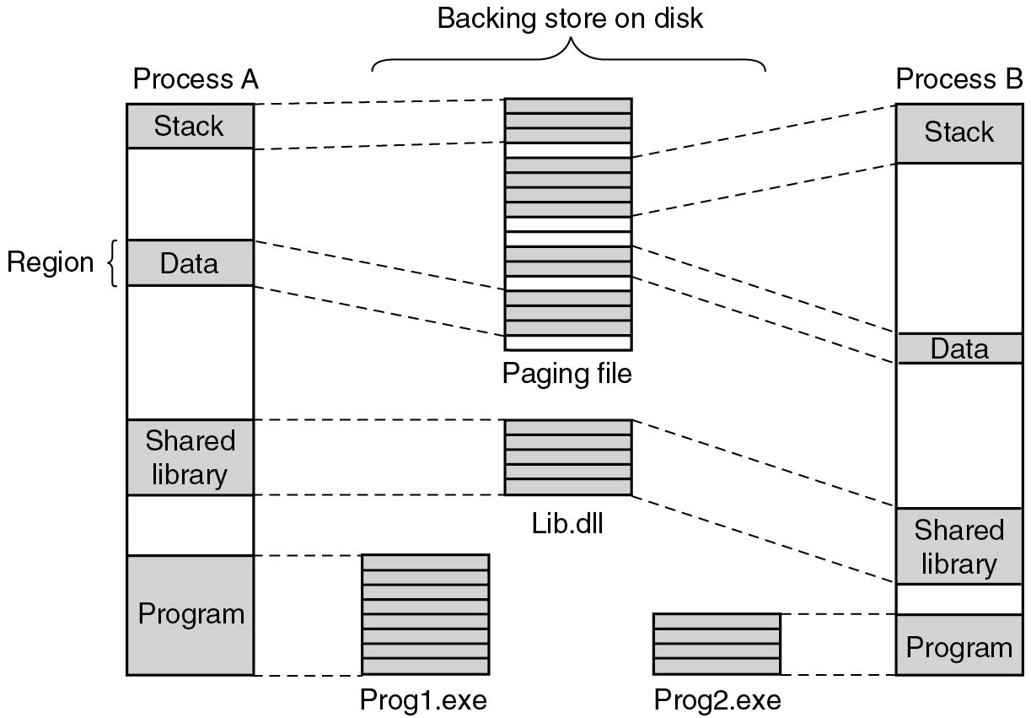
Mapped Regions
Figure 11.33 Mapped regions with their shadow pages on disk. The lib.d l l file is mapped into two address spaces at the same time.
Notes:
Long Description:
The figure consists of the vertical block labeled process A and is divided into seven rows. The first row is shaded and is labeled Stack, the second row is empty, the third row is shaded and is labeled Data, the fourth row is empty, the fifth row is shaded and is labeled Shared library, the sixth row is an empty and the seventh row is shaded and labeled Program. Stack and Data are connected to other vertical blocks labeled paging files and divided into 17 rows. A shared library is connected to another vertical block labeled Lib dot d l l and divided into 5 rows. The program is connected to another labeled Prog 1 dot e x e and divided into 8 rows. These are labeled Backing store on disk. Another vertical block is labeled process B and is divided into seven rows. The first row is shaded and is labeled Stack, the second row is empty, the third row is shaded and is labeled Data, the fourth row is empty, the fifth vertical block row is shaded and is labeled Shared library, the sixth row is empty and seventh is shaded and labeled Program. Stack and Data are connected to other vertical blocks labeled paging files and divided into 17 rows. A shared library is connected to another vertical block labeled Lib dot d l l and divided into 5 rows. The program is connected to another vertical block labeled Prog 2 dot e x e and divided into 4 rows.

Slide 37
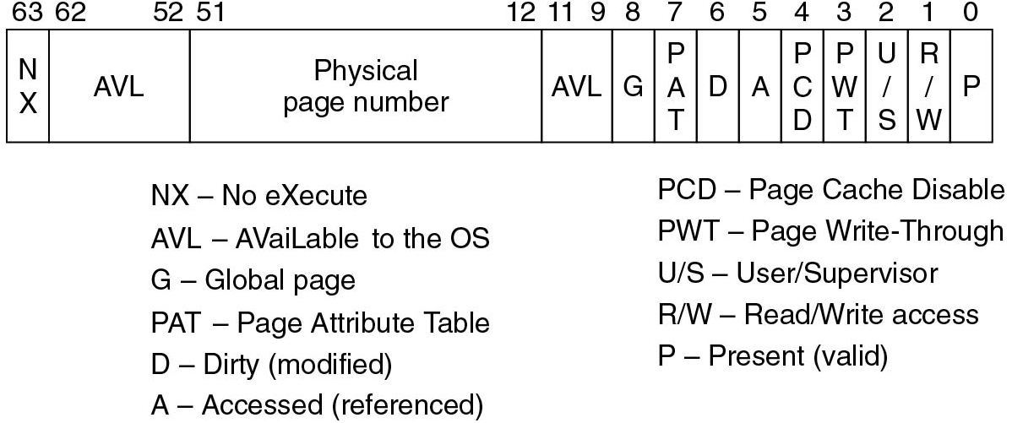
Page Table Entries
Figure 11.34 A page table entry for a mapped page on the Intel x 86 and A M D x 64 architectures.
Notes:
Long Description:
The figure consists of a horizontal block with 13 sub blocks which are labeled N X, A V L, Physical page number, A V L, G, P A T, D, A, P C D, P W T, U bar S, R bar W, and P from left to right, also these blocks define the range of Bytes 0, 1,2, 3, 4, 5, 6, 7, 8, 9, 11, 12, 51, 52, 62, 63 from right to left. The expanded form of each block follows: N X No eXecute, A V L AVaiLable to the O S, G Global page, P A T Page Attribute Table, D Dirty (modified), A Accessed (referenced), P C D Page Cache Disable, P W T Page Write-Through, U slash S User slash Supervisor, R slash W Read slash Write access, P Present (valid).

Slide 38
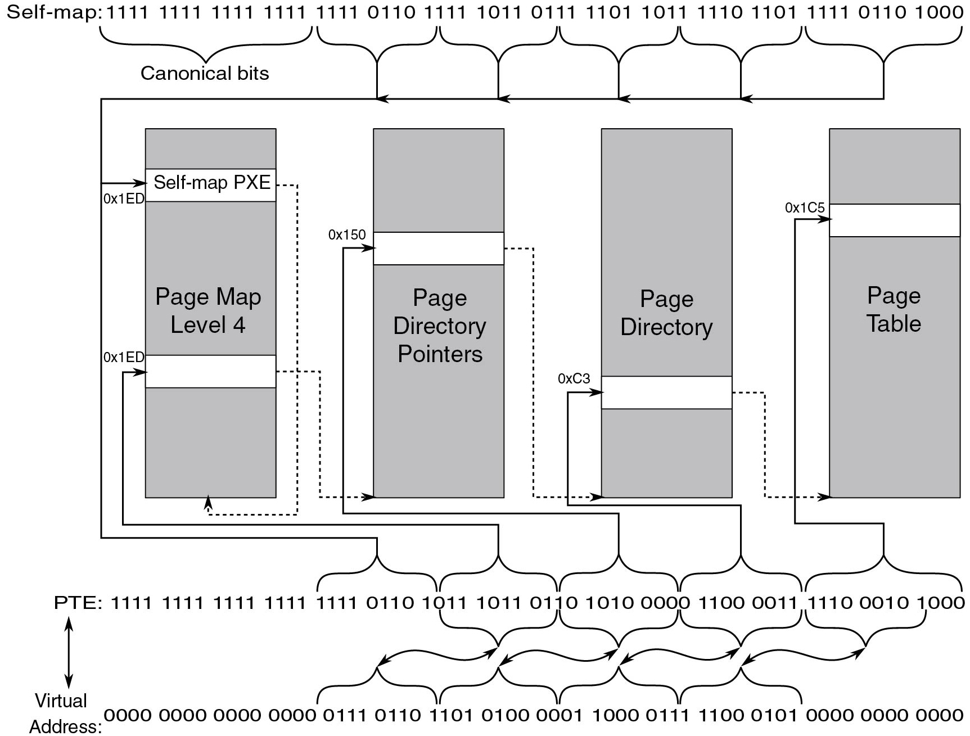
Self-Map Entries
Figure 11.35 The Windows self-map entries are used to map the physical pages into kernel virtual addresses.
Notes:
Long Description:
The figure consists of four vertical blocks labeled Page level 4, Page directory pointers, Page directory, and Page table. Canonical bits are marked above the block they are labeled Self-map: 1 1 1 1 1 1 1 1 1 1 1 1 1 1 1 1 1 1 1 1 0 1 1 0 1 1 1 1 1 0 1 1 0 1 1 1 1 1 0 1 1 0 1 1 1 1 1 0 1 1 0 1 1 1 1 1 0 1 1 0 1 0 0 0. The block Page Map level 4 has a segment on top labeled Self-map P X E and an empty segment near the center. The block Page Directory Pointers has an empty block on top. The block Page Directory has an empty segment on bottom. The block Page Table has an empty segment on top. P T E and Virtual address are labeled below the blocks, which are labeled P T E: 1 1 1 1 1 1 1 1 1 1 1 1 1 1 1 1 1 1 1 1 0 1 1 0 1 0 1 1 1 0 1 1 0 1 1 0 1 0 1 0 0 0 0 0 1 1 0 0 0 0 1 1 1 1 1 0 0 0 1 0 1 0 0 0 and Virtual Address: 0 0 0 0 0 0 0 0 0 0 0 0 0 0 0 0 0 1 1 1 0 1 1 0 1 1 0 1 0 1 0 0 0 0 0 1 1 0 0 0 0 1 1 1 1 1 0 0 0 1 0 1 0 0 0 0 0 0 0 0 0 0 0 0. A right arrow labeled 0 times 1 E D from Canonical bits points to the segment Self-map P X E in the block Page Map level 4 and the fifth quadruple 1 1 1 1 to the seventh quadruple 1 0 1 1 in P T E. A single arrow labeled 0 times 1 E D from a bracketed arrow from the seventh quadruple 1 0 1 1 to the ninth quadruple 0 1 1 0 in P T E points to the empty block in Page Map Level 4. A single arrow labeled 0 times 150 from a bracketed arrow from the ninth quadruple 0 1 1 0 to the eleventh quadruple 0 0 0 0 points to the empty segment in Page directory pointers. A single arrow labeled 0 times C 3 from the eleventh quadruple 0 0 0 0 to the thirteenth quadruple 0 0 1 1 points to the empty segment in Page directory. A single arrow labeled 0 times 1 C 5 from the thirteenth quadruple 0 0 1 1 to the fifteenth quadruple 1 0 0 0 points to the empty segment in Page Table.

Slide 39
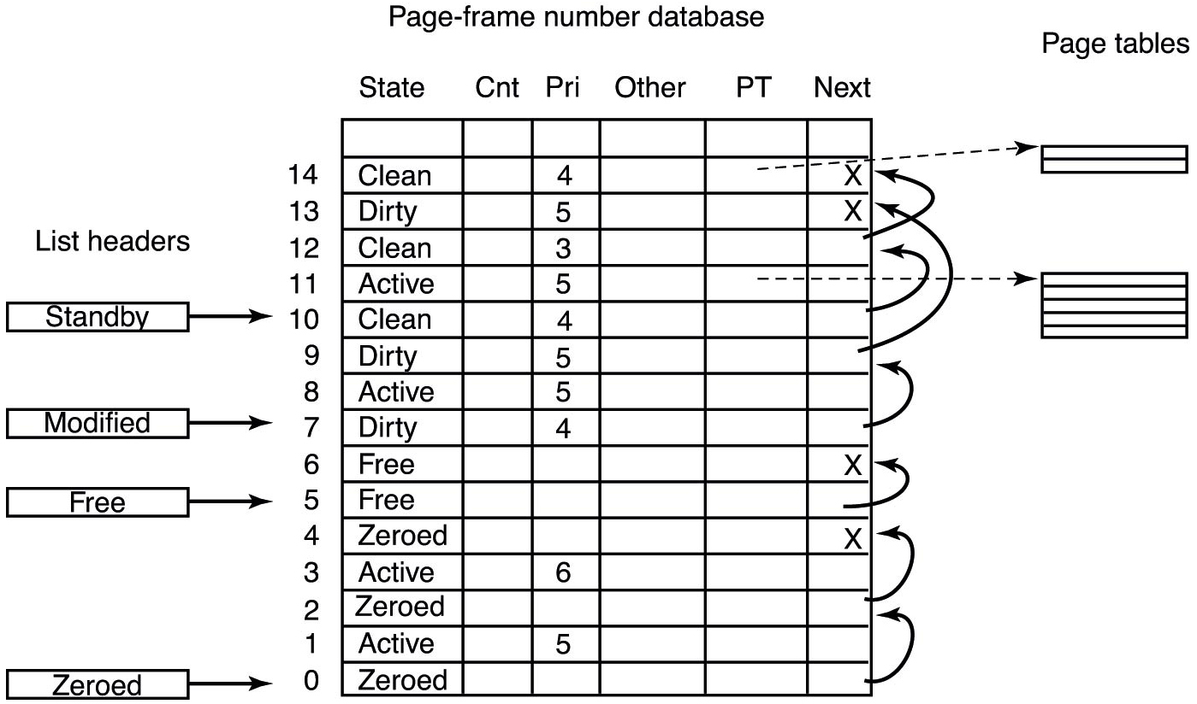
The Page-Frame Database
Figure 11.36 Some of the fields in the page-frame database.
Notes:
Long Description:
The figure shows a table titled Page frame number database with six columns and 16 rows. The column headings are State, C n t, P r i, Other, P T, and Next. The rows are numbered 0 to 14 bottom to top. The columns C n t, Other, P T and Next does not contain anything. The first row is separated by a thick dark line. The first column entries from top to bottom are as follows: Clean, Dirty, Clean, Active, Clean, Dirty, Active, Dirty, Free, Free, Zeroed, Active, Zeroed, Active, Zeroed. The third column entries from top to bottom are as follows: 4, 5, 3, 5, 4, 5, 5, 4, blank, blank, blank, 6, blank, 5, blank. Four blocks of headed List headers are placed left of the table. The first block labeled Standby pointed a one sided arrow towards row 6. The second block labeled Modified pointed a one sided arrow towards row 9. The third block labeled Free pointed a one sided arrow towards row 11. The fourth block labeled Zeroed pointed a one sided arrow towards row 16. The second row is connected to blocks containing two segments and the fifth row is also connected to blocks containing five segments.

Slide 40
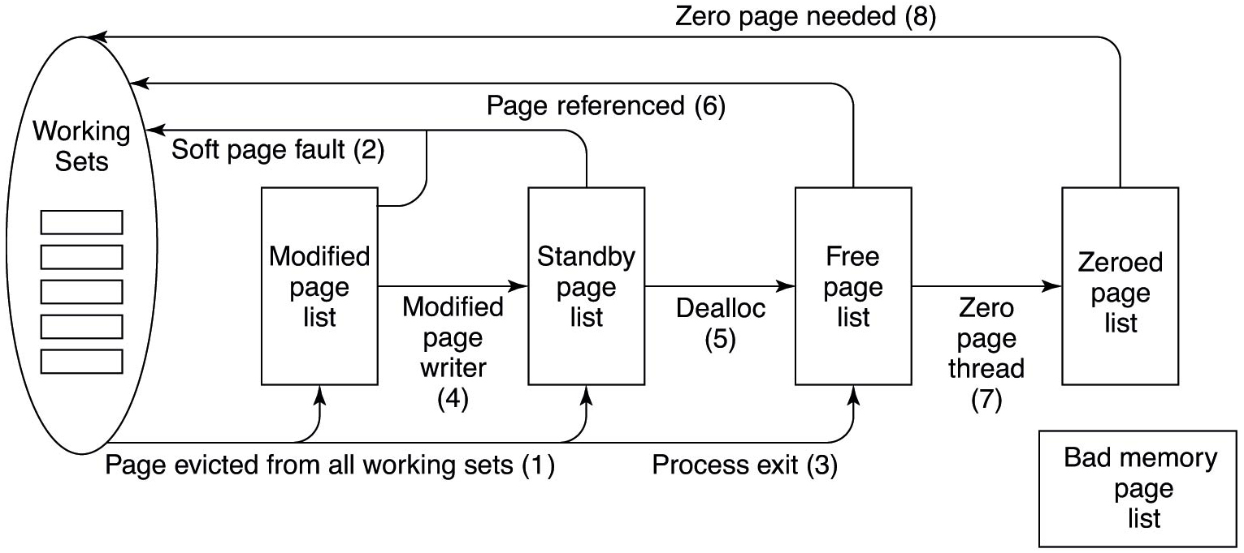
Page Lists
Figure 11.37 The various page lists and the transitions between them.
Notes:
Long Description:
The figure shows the first elliptical block labeled Working sets, a forward arrow labeled page evicted from all working sets (1) to a rectangular block is labeled Modified page list, a forward arrow labeled Modified page writer (4) to the second rectangular block is labeled Standby page list and one forward arrow is coming from the elliptical block to the next rectangular block and the block is showing a backward arrow Soft page fault (2) to the elliptical block. A forward arrow labeled Dealloc (5) to the third rectangular block is labeled Free page list and one forward arrow is coming from the elliptical block to the rectangular block and labeled Process exit (3) the block is showing a backward arrow Page referenced (6) to the elliptical block. A forward arrow labeled Zero page thread (7) to the next rectangular block is labeled Zeroed page list and the block is showing a backward arrow labeled Zero page needed (8) to the elliptical block. A rectangular block is labeled Bad memory page list which is placed on the right bottom corner of the figure.

Slide 41
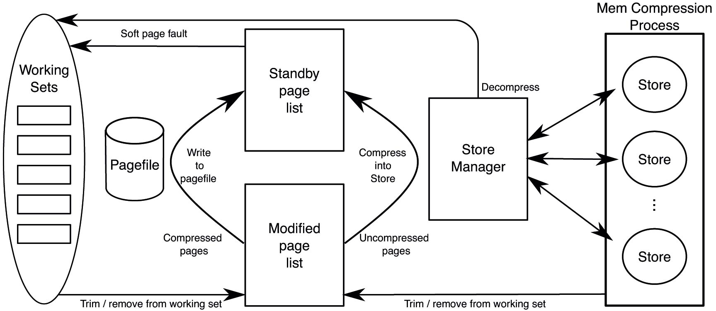
Page Transitions With Memory Compression
Figure 11.38 Page transitions with memory compression (free/zero lists omitted here).
Notes:
Long Description:
The figure shows the first elliptical block labeled Working sets, a forward arrow labeled Trim or remove from working set to second rectangular block is labeled Modified page list, an arrow pointed upward labeled compressed pages and write to page file to next rectangular block is labeled Standby page list and the block is showing a backward arrow labeled Soft page fault to the elliptical block. Also, an upward arrow labeled uncompressed pages and compress into stores from the modified page list block to the standby page list block. A cylindrical-shaped block labeled Page File is placed next to the elliptical block. A rectangular block is labeled Store manager, and a backward arrow labeled Decompress is pointing to the elliptical block. Three two sided arrows to the vertical block labeled Mem compression process consist of three circles labeled store, and a backward arrow towards Modified page list block which is labeled Trim bar remove from working set.

Slide 42
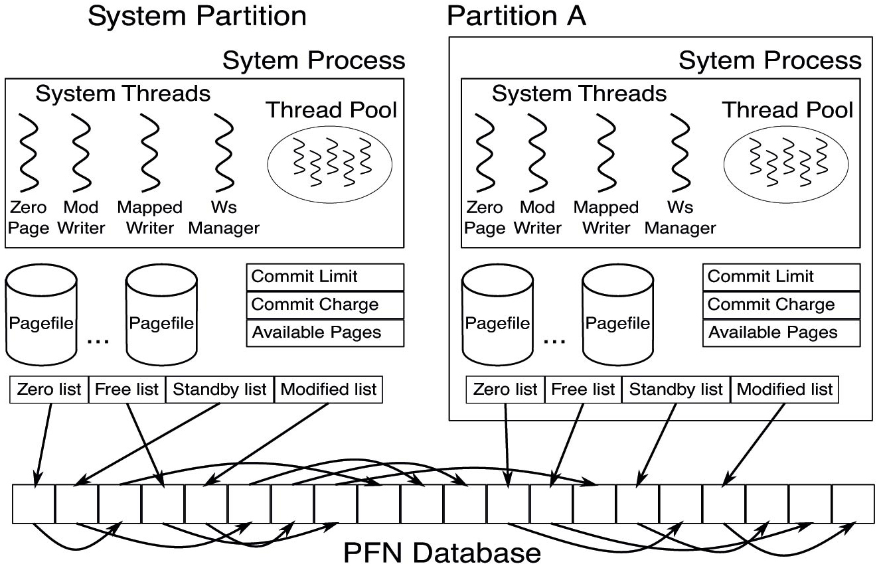
Memory Partitions
Figure 11.39 Memory partition data structures.
Notes:
Long Description:
The figure consists of two rectangular blocks labeled System Partition and System Process which consists of a Thread pool and four System Threads and labeled Zero Page, Mod Writer, Mapped Writer, and W s Manager. Two cylindrical blocks are labeled Page File and three segmented blocks are labeled Commit Limit, Commit Charge, and Available Pages, and a horizontal block of four parts labeled Zero list, Free list, Stand by list, and Modified list which are placed below the rectangular block. Another rectangular block is labeled Partition A which consists of a Thread pool and four System Threads and is labeled Zero Page, Mod Writer, Mapped Writer, and W s Manager. Two cylindrical blocks are labeled Page File and three-segmented blocks which are labeled Commit Limit, Commit Charge, and Available Pages and a horizontal block of four parts labeled Zero list, Free list, Standby list, and Modified list. Four arrows are connected to the horizontal block which is divided into 20 parts and labeled P F N Database. A one sided arrow is connected to the parts.

Slide 43
Native N T Calls for I/O
I/O system call | Description
N t Create File | Open new or existing files or devices
N t Read File | Read from a file or device
N t Write File | Write to a file or device
N t Query Directory File | Request information about a directory, including files
N t Query Volume Information File | Request information about a volume
N t Set Volume Information File | Modify volume information
N t Notify Change Directory File | Finishes when any file in the directory or subtree is modified
N t Query Information File | Request information about a file
N t Set Information File | Modify file information
N t Lock File | Lock a range of bytes in a file
N t Unlock File | Remove a range lock
N t F s Control File | Miscellaneous operations on a file
N t Flush Buffers File | Flush in-memory file buffers to disk
N t Cancel I o File | Cancel outstanding I/O operations on a file
N t Device I o Control File | Special operations on a device
Figure 11.40 Native N T A P I calls for performing I/O.

Slide 44
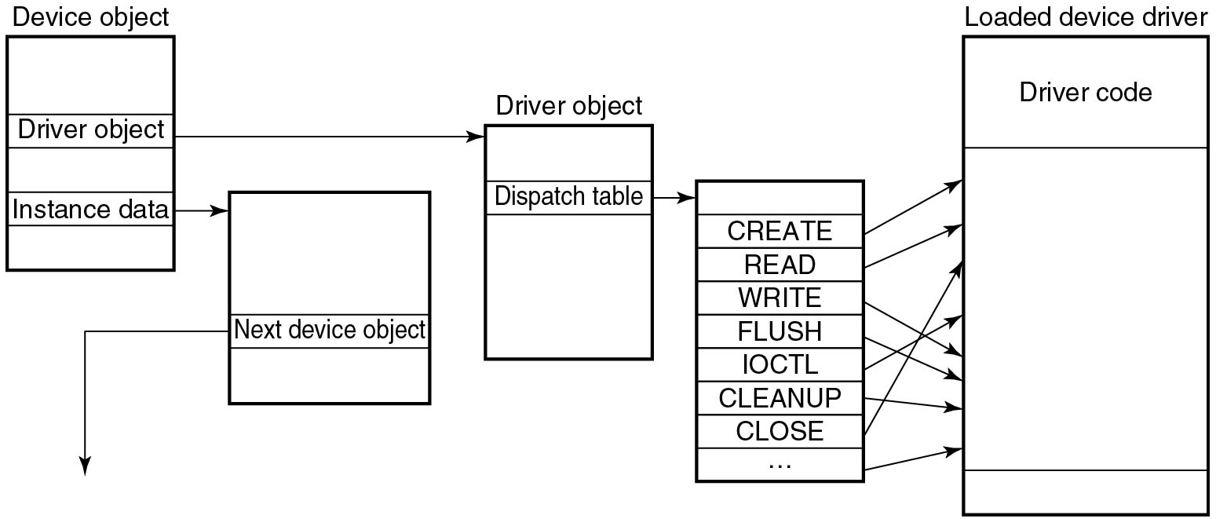
Device Drivers
Figure 11.41 A single level in a device stack.
Notes:
Long Description:
The figure shows five vertical blocks. The first block is labeled Device object and subdivided into five parts, in which the second and fourth part is labeled Driver object and Instance data. A forward arrow is pointing from instance data to the second vertical block which is labeled the next device object inside the block and an arrow is showing from this block in a downward direction. A forward arrow is pointing from the driver object to the third vertical block which is labeled driver object and inside the block is labeled dispatch table. A forward arrow is pointing from the dispatch table to the next vertical block which is divided into nine rows, the row entries are the first row is empty, and the next rows are CREATE, READ, WRITE, FLUSH, I O C T L, CLEAN UP, and CLOSE. A one sided arrow is connected from each row to the next vertical block which is labeled Loaded device driver and the Driver code is marked inside the block.

Slide 45
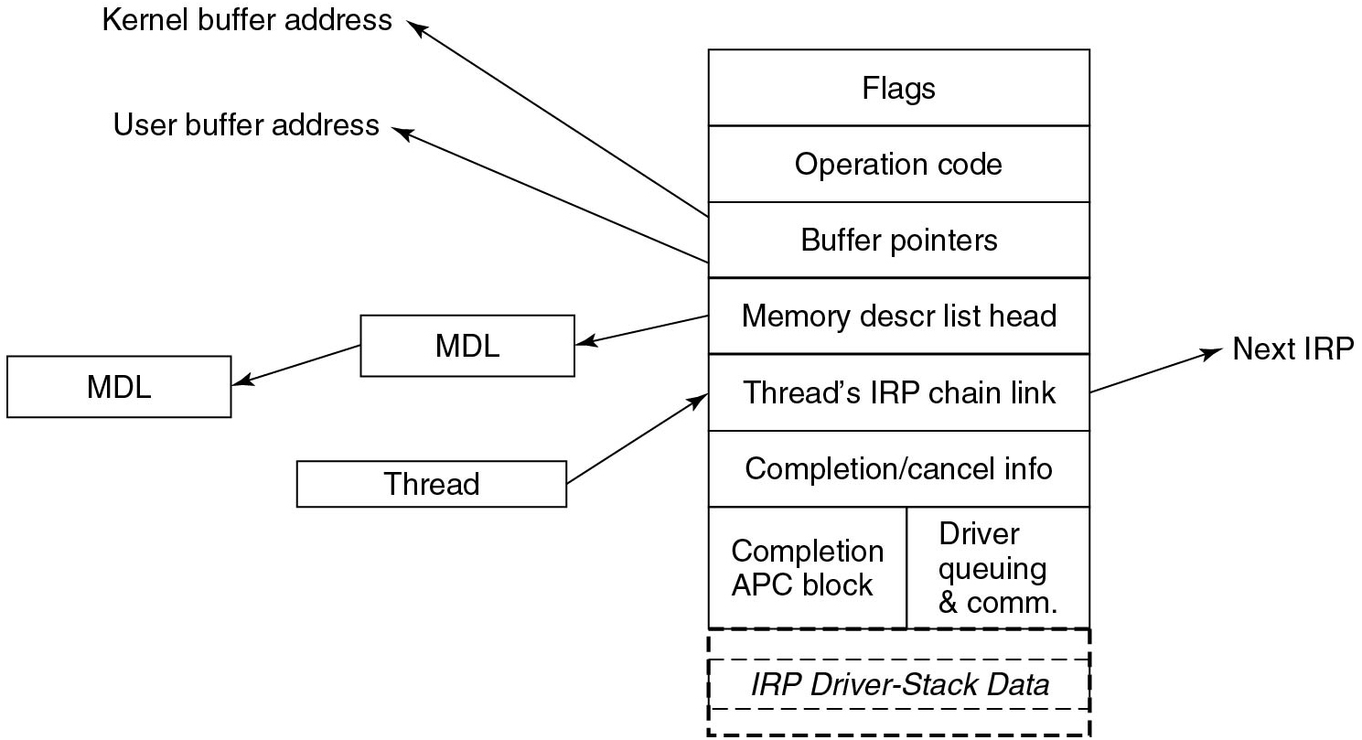
I/O Request Packets
Figure 11.42 The major fields of an I/O Request Packet.
Notes:
Long Description:
The figure shows a vertical block consisting of eight rows. The row entries are as follows: Flags, Operation code, Buffer pointers, Memory description list head, Thread’s I R P chain link, Completion slash cancel info, Completion A P C block, and Driver queuing and communication, I R P Driver-Stack Data. The seventh row is divided into two parts. Two one sided arrows are pointed outside from the row of Buffer pointers and labeled Kernel buffer address and User buffer address. Another one sided arrow is pointed outside from the row of Memory description list head to the block labeled M D L and followed by another same M D L block. The block labeled Thread placed outside is showing a one sided arrow pointed towards Thread’s I R P chain link row and an arrow coming from the same row to the outside and labeled Next I R P.

Slide 46
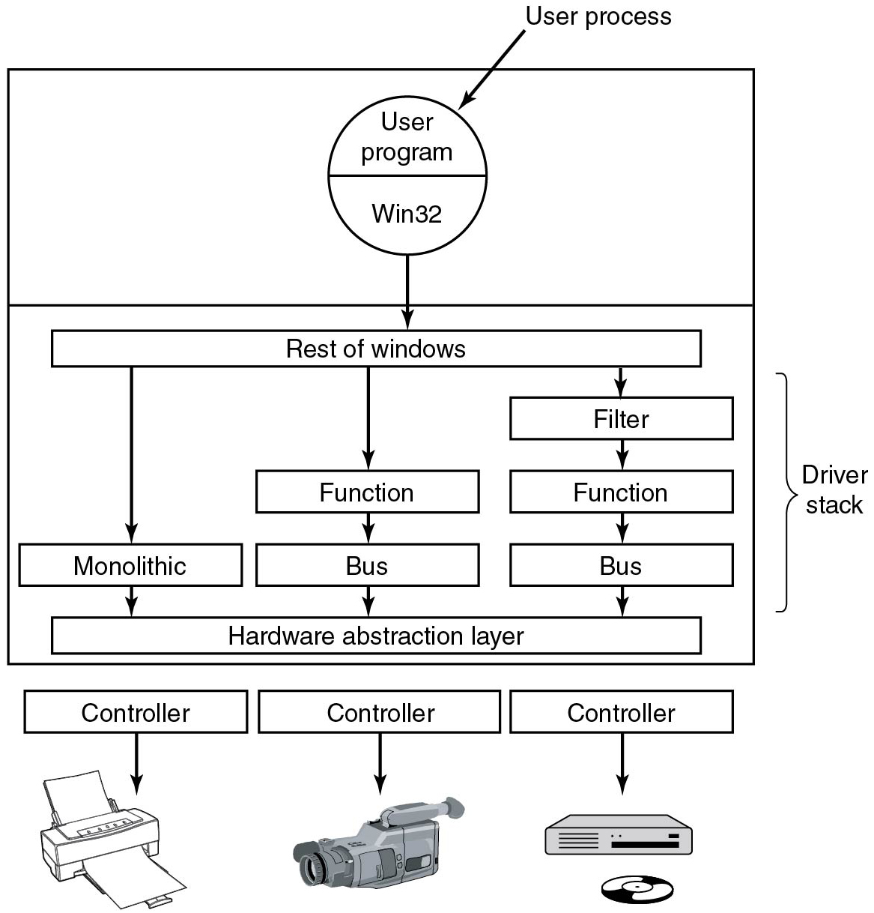
Stacked Drivers
Figure 11.43 Windows allows drivers to be stacked to work with a specific instance of a device.
Notes:
Long Description:
The figure consists of a vertical block consisting of two layers. The first layer consists of a circle divided into two parts, the upper part is labeled User program and the lower part is labeled Win32. A sided arrow is pointed toward the circle and labeled User process. The second layer is labeled Driver stack and it consists of a block diagram. The block is labeled Rest of windows, an arrow is pointed towards this block from the circle. This block is pointing three arrows toward the Monolithic block, Function block, and Filter block. The Monolithic block is pointing an arrow toward the Hardware abstraction layer block. The Function block is pointing an arrow toward the Bus block and the Bus block is pointing an arrow toward the Hardware abstraction layer block. The Filter block is pointing an arrow toward the function block, the Function block is pointing an arrow toward the Bus block and the Bus block is pointing an arrow toward the Hardware abstraction layer block. Three controller blocks are placed below the vertical block and are connected to three devices.

Slide 47
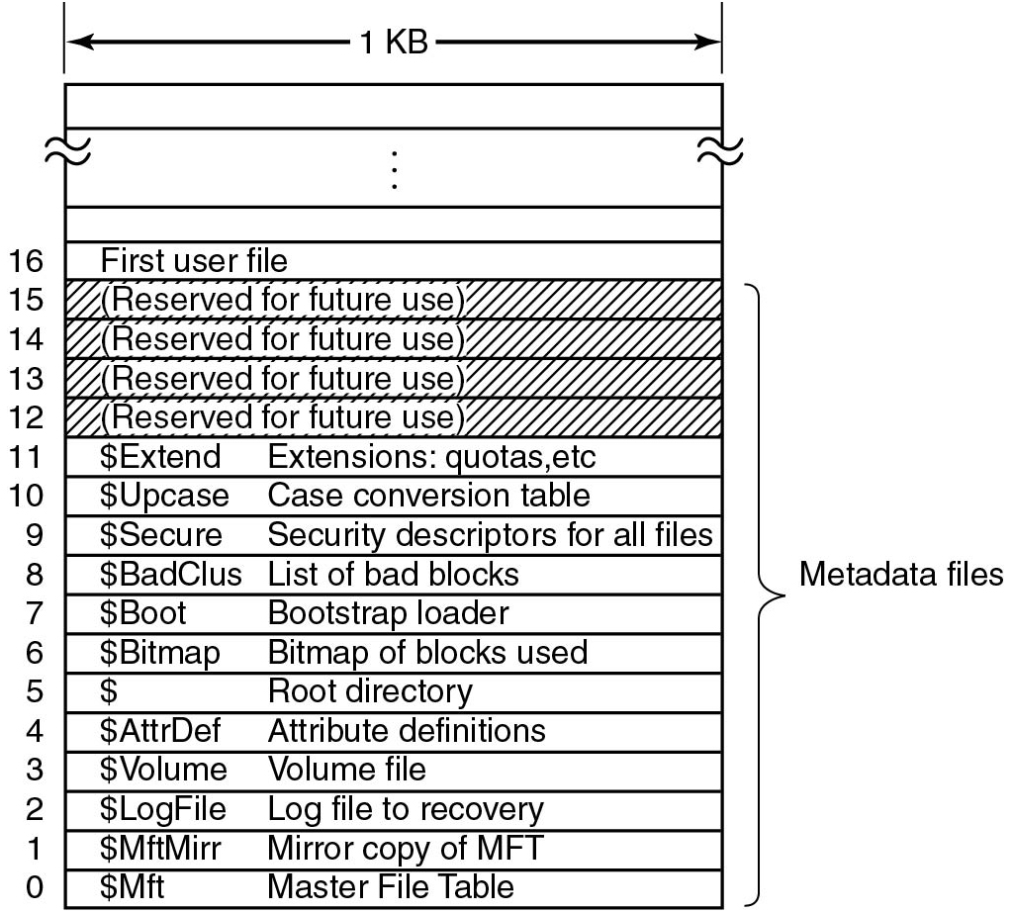
The N T F S Master File Table
Figure 11.44 The N T F S master file table.
Notes:
Long Description:
The figure consists of a vertical block labeled 1 K B with 20 rows marked 0 to 16 from bottom to top.The first three rows do not contain anything, from the fourth row the row entries are as follows: First user file, (Reserved for future use), (Reserved for future use), (Reserved for future use), (Reserved for future use), dollar symbol Extend Extensions: quotas, dollar symbol Up case Case conversion table, dollar symbol Secure Security descriptors for all files, dollar symbol Bad Clus List of bad blocks, dollar symbol Boot Bootstrap loader, dollar symbol Bitmap Bitmap of blocks used, dollar symbol Root directory, dollar symbol A t t r Def Attribute definitions, dollar symbol Volume Volume file, dollar symbol Log File Log file to recovery, dollar symbol M f t Mirr Mirror copy of M F T, and dollar symbol M f t Master File Table. The rows marked from 0 to 15 are labeled Metadata files.

Slide 48
Master File Table Attributes
Attribute | Description
Standard information | Flag bits, time stamps, etc.
File name | File name in Uni code; may be repeated for M S-DOS name
Security descriptor | Obsolete. Security information is now in $Extend $Secure
Attribute list | Location of additional M F T records, if needed
Object I D | 64-bit file identifier unique to this volume
Reparse point | Used for mounting and symbolic links
Volume name | Name of this volume (used only in $Volume)
Volume information | Volume version (used only in $Volume)
Index root | Used for directories
Index allocation | Used for very large directories
Bit map | Used for very large directories
Logged utility stream | Controls logging to $Log File
Data | Stream data; may be repeated
Figure 11.45 The attributes used in M F T records.

Slide 49
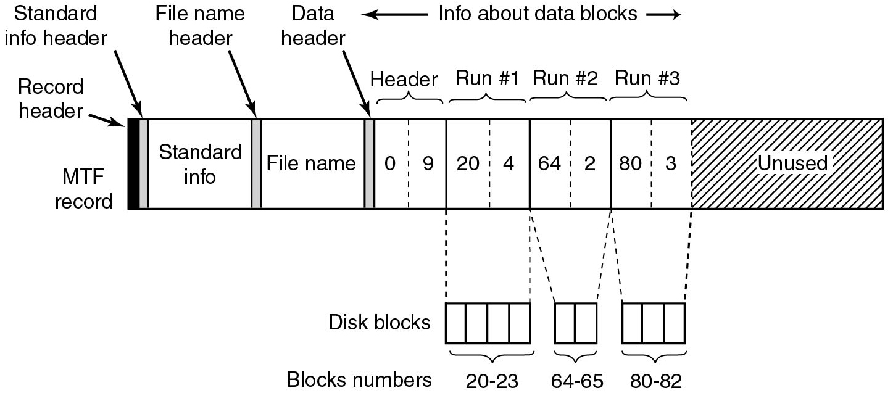
M F T Block Runs
Figure 11.46 An M F T record for a three-run, nine block stream.
Notes:
Long Description:
The figure consists of a horizontal block that is divided into seven parts. The first part is labeled Standard info and is showing two arrows pointed to this block and marked Standard info header and Record header, the block is also labeled with M T F record. The second part is labeled File name and is showing an arrow pointed to this block and marked Filename header. The third block is labeled header, which is subdivided into two parts and marked 0 and 9. An arrow pointed to the header block is marked Data header. The fourth block is labeled Run hash 1 which is subdivided into two parts and marked 20 and 4 and the block is connected to another disk block containing four segments and labeled block numbers 20 to 23. The fifth block is labeled Run hash 2 which is subdivided into two parts and marked as 64 and 2 and the block is connected to another disk block containing two segments and labeled block numbers 64 to 65. The sixth block is labeled Run hash 3 which is subdivided into two parts and marked as 80 and 3 and the block is connected to another disk block containing three segments and labeled block numbers 80 to 82. The seventh block is labeled Unused. The third, fourth, fifth, and sixth blocks together labeled info about data blocks.

Slide 50
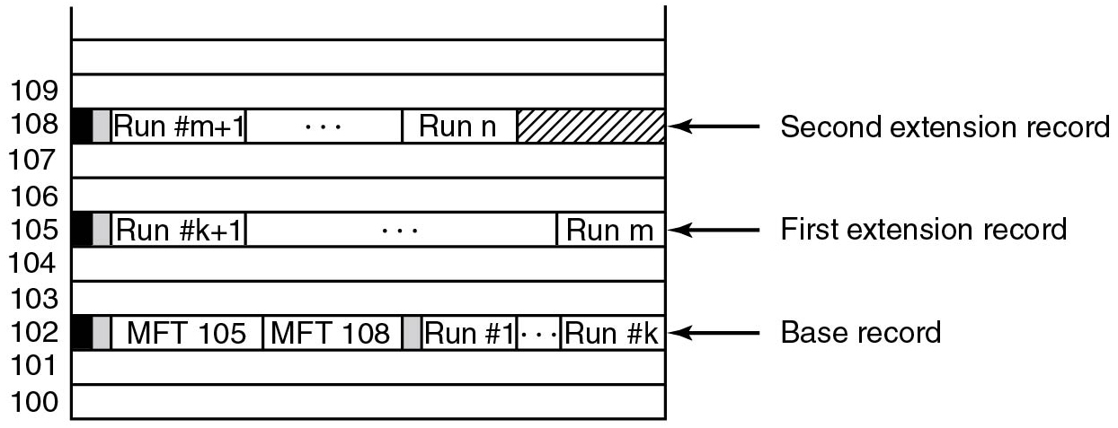
A File with Three M F T Records
Figure 11.47 A file that requires three M F T records to store all its runs.
Notes:
Long Description:
The figure consists of a vertical block with 11 rows labeled 100 to 109 from bottom to top. The first two rows are empty, the third row is labeled Second extension record and it is divided into five parts which are labeled Run hash m plus 1 and Run n. The next two rows are empty, the sixth row is labeled First extension record and it is divided into three parts which are labeled Run hash k plus 1 and Run n. The next two rows are empty, the ninth row is labeled Base record and it is divided into five parts which are labeled M F T 105, M F T 108, Run hash 1, and Run hash k and the next two rows are empty.

Slide 51
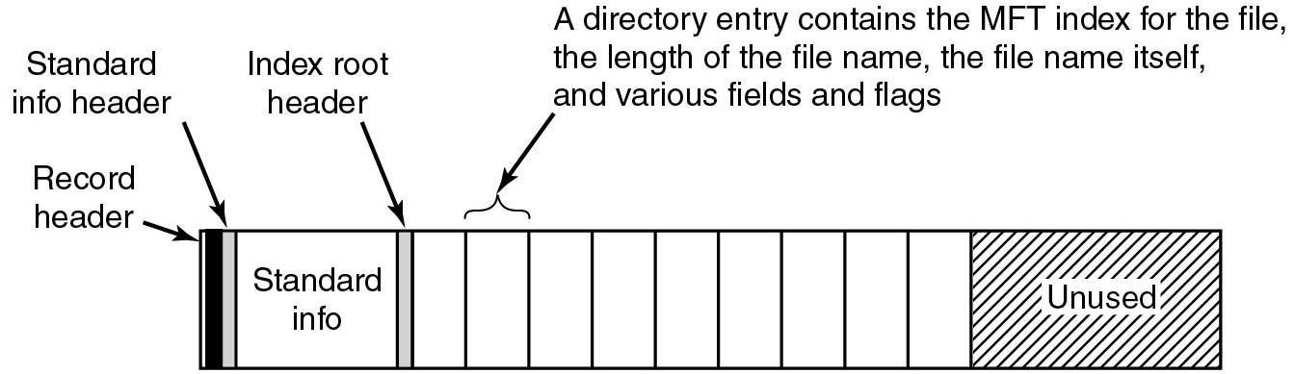
Directory Records
Figure 11.48 The M F T record for a small directory.
Notes:
Long Description:
The figure consists of a horizontal block that is divided into 11 parts. The first part is labeled Standard info and is showing two arrows pointed to this block and marked Standard info header and Record header. The second part is showing an arrow pointed to this block and marked the Index root header and the third part is labeled A directory entry contains the M F T index for the file, the length of the file name, the file name itself, and various fields and flags. The next parts are empty and the last part is labeled Unused.

Slide 52
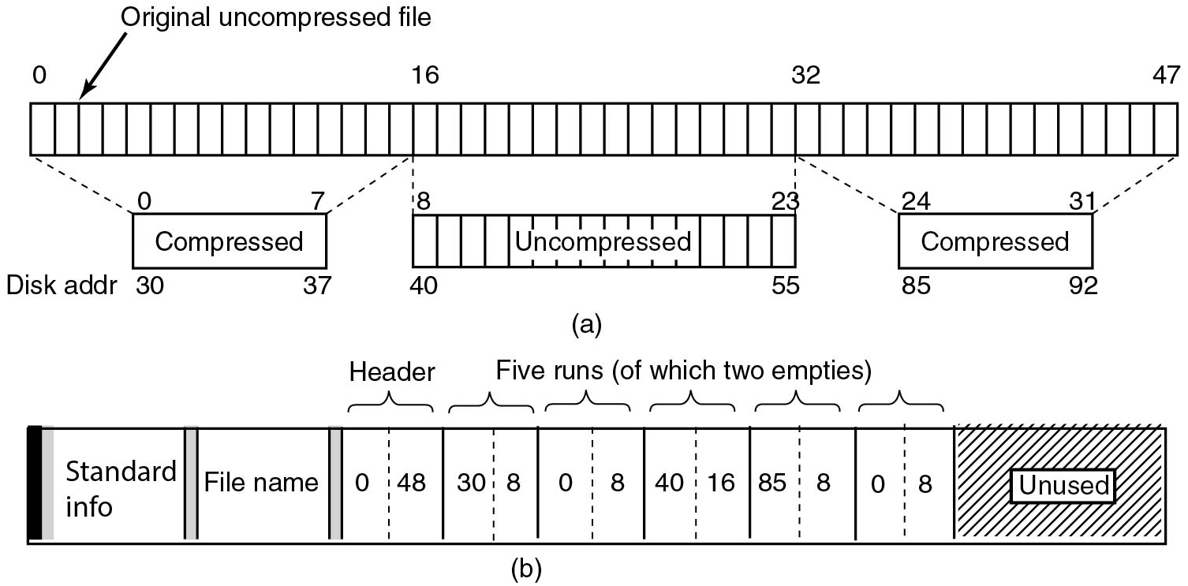
File Compression
Figure 11.49 (a) A 48-block being compressed. (b) The M F T record after compression.
Notes:
Long Description:
Part (a): The horizontal block shown is divided into 48 parts labeled 0 to 47. An arrow is pointed to the second row and labeled Original uncompressed file. Three other blocks are connected to the horizontal block. The first block is labeled Compressed and marked 0 to 7 on the upper portion and disk address 30 to 37 on the lower portion, the block is connected by a dotted line from the first 16 parts of the horizontal block. The second block is labeled Uncompressed which is divided into 16 parts and marked 8 to 23 on the upper portion and disk address 40 to 55 on the lower portion, the block is connected by a dotted line from the 16 to 32 parts of the horizontal block. The third block is labeled compressed and marked 24 to 31 on the upper portion and disk address 85 to 92 on the lower portion, the block is connected by a dotted line from the 32 to 47 parts of the horizontal block. Part(b): The horizontal block shows that divided into 9 parts. The first part is labeled Standard info and the second part is labeled Filename. The third part is labeled Header which is subdivided into two parts and labeled 0 and 48. The fourth part is subdivided into two parts and labeled 30 and 8. The fifth part is subdivided into two parts and labeled 0 and 8. The sixth part is subdivided into two parts and labeled 40 and 16. The seventh part is subdivided into two parts and labeled 85 and 8. The eighth part is subdivided into two parts and labeled 0 and 8. The last part is labeled Unused. The fourth, fifth, sixth, seventh, and eighth part is together labeled Five runs (of which two empties).

Slide 53
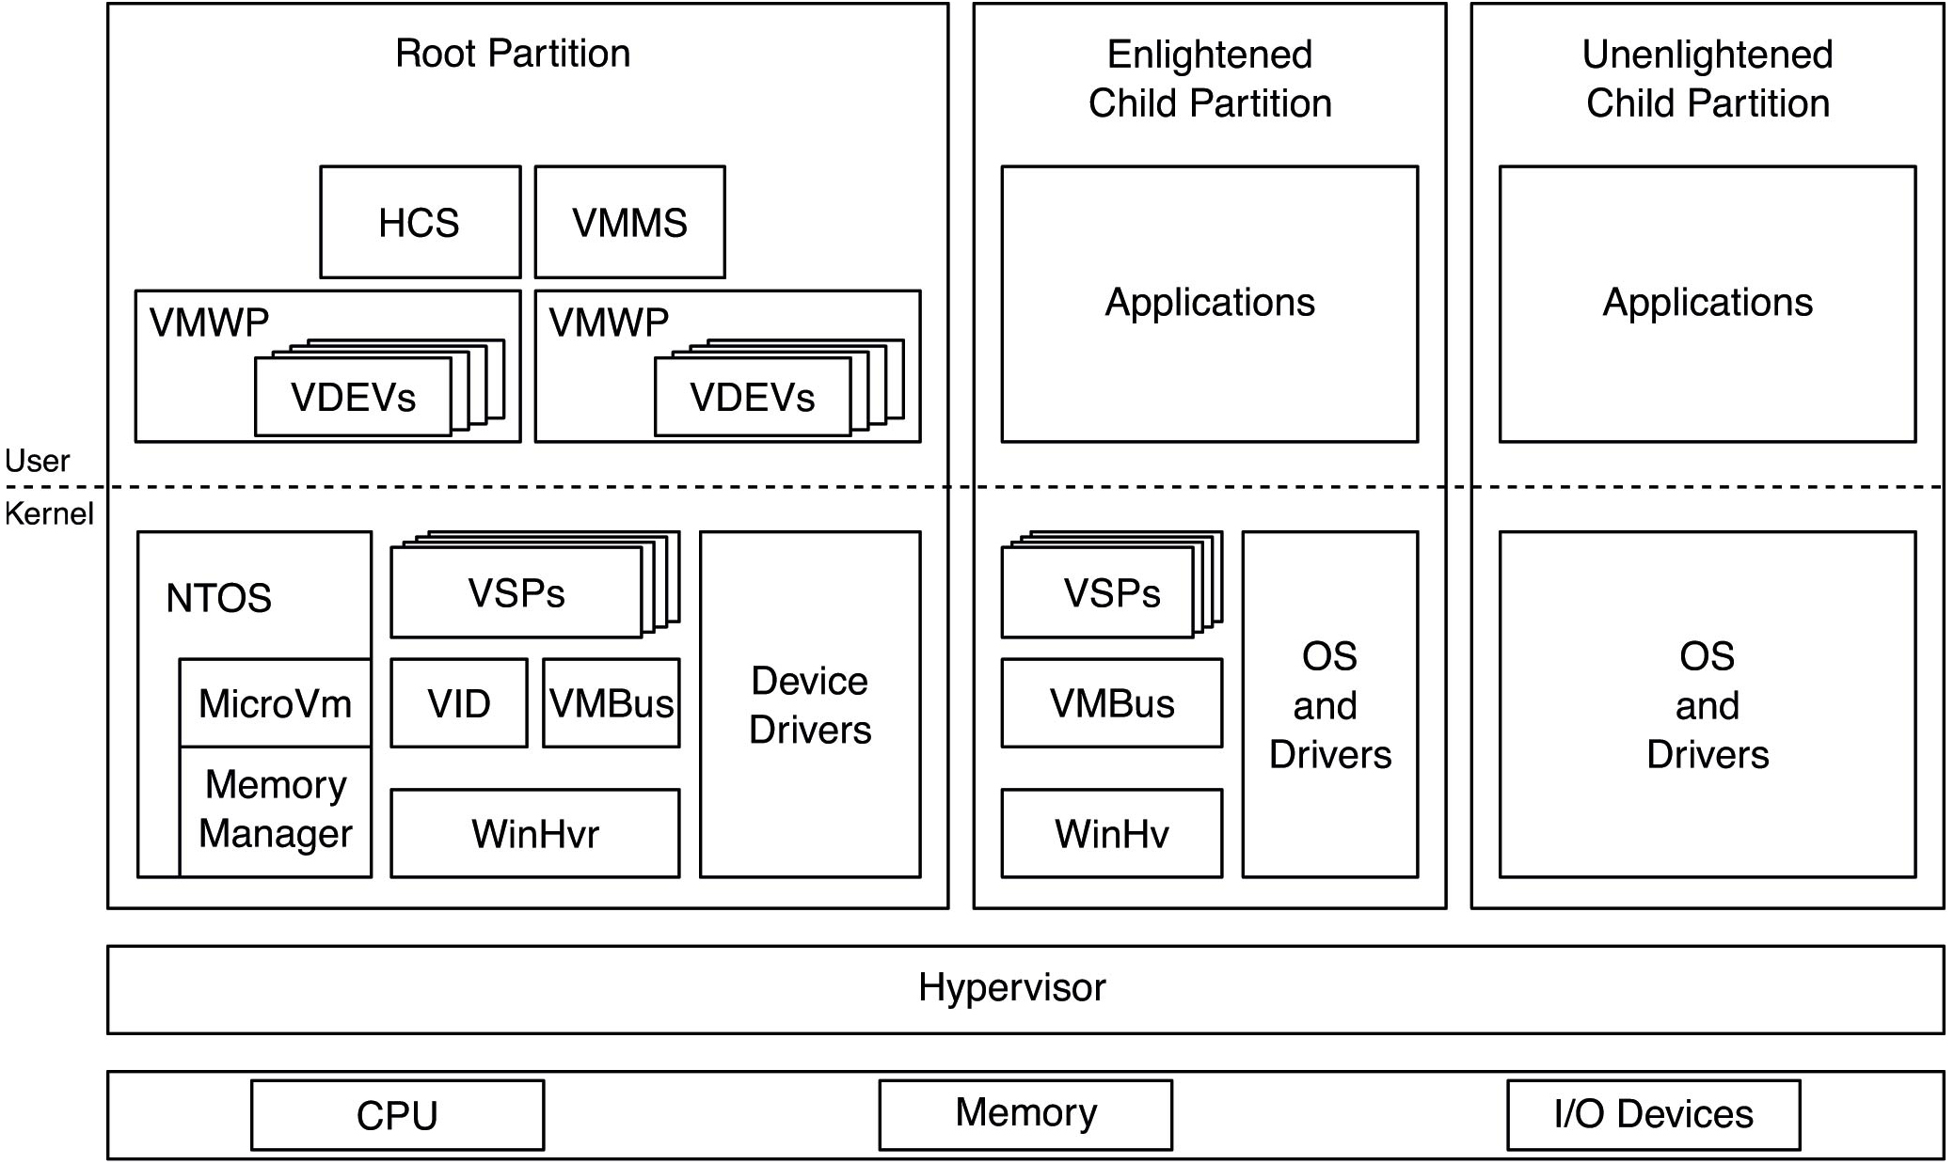
Virtualization
Figure 11.50 Hyper-V virtualization components in the root and child partitions.
Notes:
Long Description:
The figure consists of three vertical blocks and two horizontal blocks. A horizontal dotted line is passing through the mid of these three vertical blocks which divides the blocks into two parts. The first vertical block is labeled Root partition, the upper part of the block is consist of four sub-blocks labeled H C S, V M M S, V M W P, and V DEVs, V M W P, and VDEVs and the lower part of the block is consist of eight sub-blocks labeled N T O S, Micro V m, Memory Manager, V S Ps, V I D, V M Bus, Win H v r, Device drivers. The second vertical block is labeled Enlightened child partition, the upper part of the block is consist of one sub-block labeled Applications and the lower part of the block is consist of eight sub-blocks labeled V S P s, V M Bus, Win H v, O S, and drivers. The third vertical block is labeled unenlightened child partition, the upper part of the block is consist of one sub-block labeled Applications and the lower part of the block is consist of eight sub-blocks labeled O S and drivers. The horizontal block is labeled Hypervisor and another horizontal block is divided into three sub-blocks which are labeled C P U, Memory, and I bar O devices.

Slide 54
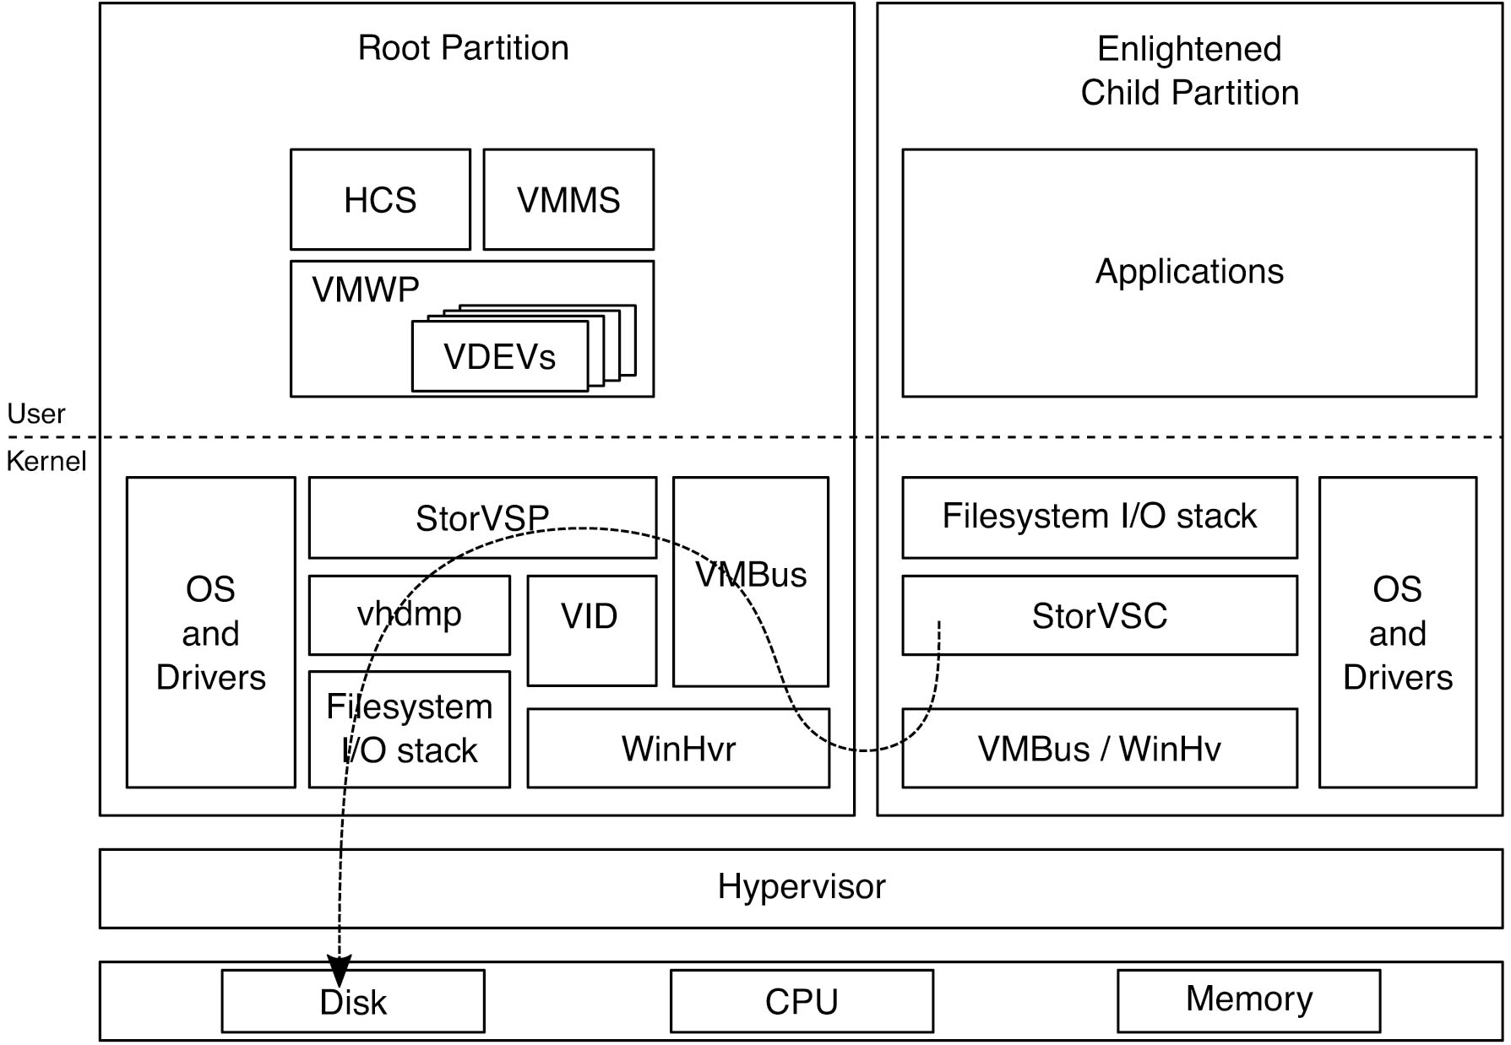
Paravirtualized I/O
Figure 11.51 Flow of paravirtualized I/O for an enlightened guest O S.
Notes:
Long Description:
The figure consists of two vertical blocks and two horizontal blocks. A horizontal dotted line is passing through the mid of these three vertical blocks which divides the blocks into two parts. The first vertical block is labeled Root partition, the upper part of the block is consist of seven sub-blocks labeled H C S, V M M S, V M W P, and V DEVs and the lower part of the block is consist of eight sub-blocks labeled OS and Drivers, Stor V S P, champ, V I D, Filesystem I bar O stack, V M Bus, Win H v r. The second vertical block is labeled Enlightened child partition, the upper part of the block is consist of one sub-block labeled Applications and the lower part of the block is consist of four sub-blocks which are labeled Filesystem I bar O stack, Stor V S C, V M Bus bar Win H v, O S and drivers. The horizontal block is labeled Hypervisor and another horizontal block is divided into three sub-blocks which are labeled Disk, C P U, and Memory. A one-sided dotted arrow is pointing from Stor V S C to the Disk.

Slide 55
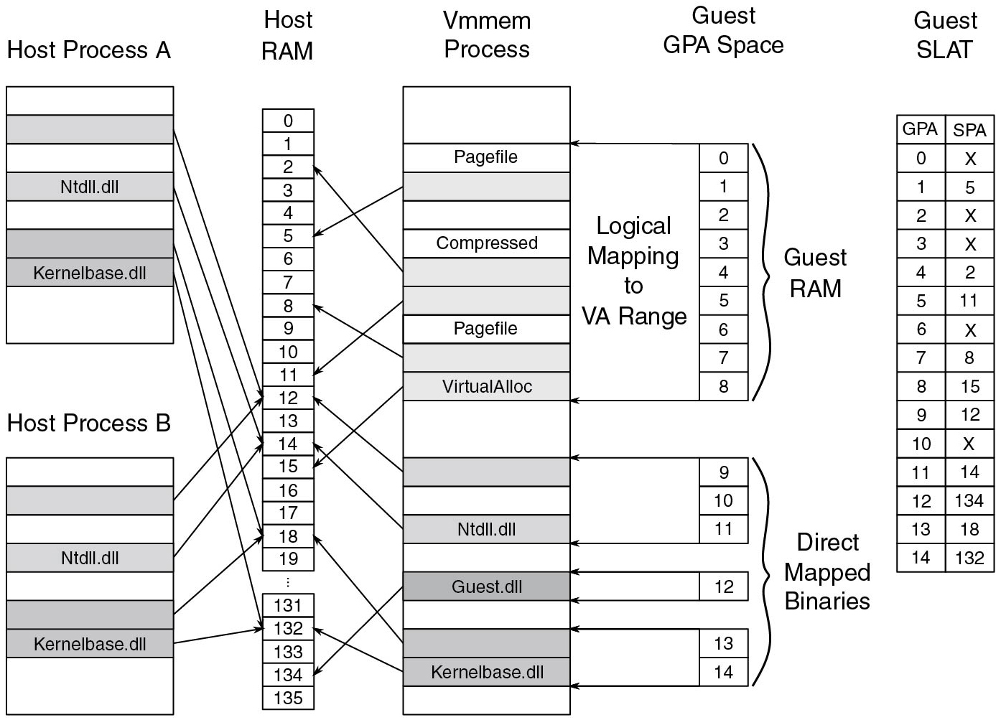
V A-Backed V M s
Figure 11.52 V A-backed V M’s G P A space is logically mapped to virtual address ranges in its v m mem process on the host.
Notes:
Long Description:
The figure shows two vertical blocks placed one below another and titled Host process A and Host process B. Both blocks are divided into eight rows, the first row is empty, the second row is shaded, the third row is empty, the fourth row is shaded and labeled N t d l l dot d l l, the fifth row is empty, the sixth row is shaded, the seventh row is shaded and labeled Kernel base dot d l and the last row are empty. The next vertical block is titled Host RAM and it is divided into 136 rows which are labeled 0 to 135 from top to bottom. An arrow is pointing from the second row of the Host process A and Host process B block to the 12th row of the Host RAM. An arrow is pointing from the fourth row of the Host process A and Host process B block to the 14th row of the Host RAM. An arrow is pointing from the sixth row of the Host process A and Host process B block to the 18th row of the Host RAM. An arrow is pointing from the seventh row of the Host process A and Host process B block to the 132 th row of the Host RAM. Another vertical block is titled the V m mem process and it is divided into 20 rows. The first row is empty, next row is labeled page file, next row is shaded and a one sided arrow pointed to the 5 th row of the Host RAM, next row is empty, next row is labeled Compressed, next two rows are shaded and a one sided arrow pointed to the second and 11 th row of the Host RAM, next row is labeled page file, next row is shaded and a one sided arrow pointed to the 8 th row of the Host RAM, next row is labeled VirtualAlloc and a one sided arrow pointed to the 15 th row of the Host RAM, next row is empty, next row is shaded and a one sided arrow pointed to the 12 th row of the Host RAM, next row is empty, next row is labeled N t d l l. d l l and a one sided arrow pointed to the 14 th row of the Host RAM, next row is empty, next row is labeled Guest dot d l l l and a one sided arrow pointed to the 134 th row of the Host RAM, next row is empty, next row is shaded and a one sided arrow pointed to the 18 th row of the Host RAM, next row is labeled Kernelbase.dll and a one sided arrow pointed to the 132 th row of the Host RAM, and last row is empty. A vertical block of 9 rows marked 0 to 8 from top to bottom and labeled Guest RAM and Logical mapping to V A Range is connected to the second and tenth row of the V m mem process block. Three segmented blocks which are labeled 9, 10, and 11 connected to the 12th and 14th row of the V m mem process block, one segmented block which is labeled 12 connected to the 16th row of the V m mem process block, and two-segmented blocks which are labeled 13 and 14 connected to the 18th and 19th row of the V m mem process block. A table titled Guest S L A T consists of two columns and 16 rows. The columns are titled G P A and S P A. The G P A column entries are 0 to 14 from top to bottom and S P A column entries are as follows: X, 5, X, X, 2, 11, X, 8, 15, 12, X, 14, 134, 18 and 132.

Slide 56
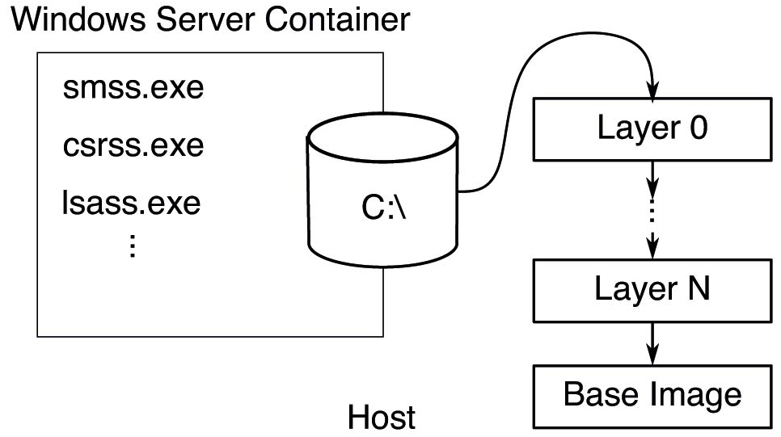
Virtual Hard Disks
Figure 11.53 The contents of the V H D exposed to the container is backed by a set of host directories.
Notes:
Long Description:
The figure shows a square block labeled Windows server container and it is connected to a cylindrical shaped body labeled C: backward slash. Inside the block is labeled s m s s dot exe, c s r s s dot exe, and I s a s s dot exe. This cylindrical block is pointing an arrow toward another rectangular block labeled Layer 0. This block is pointing an arrow toward Layer 1. This block is pointing an arrow toward the Base image.

Slide 57
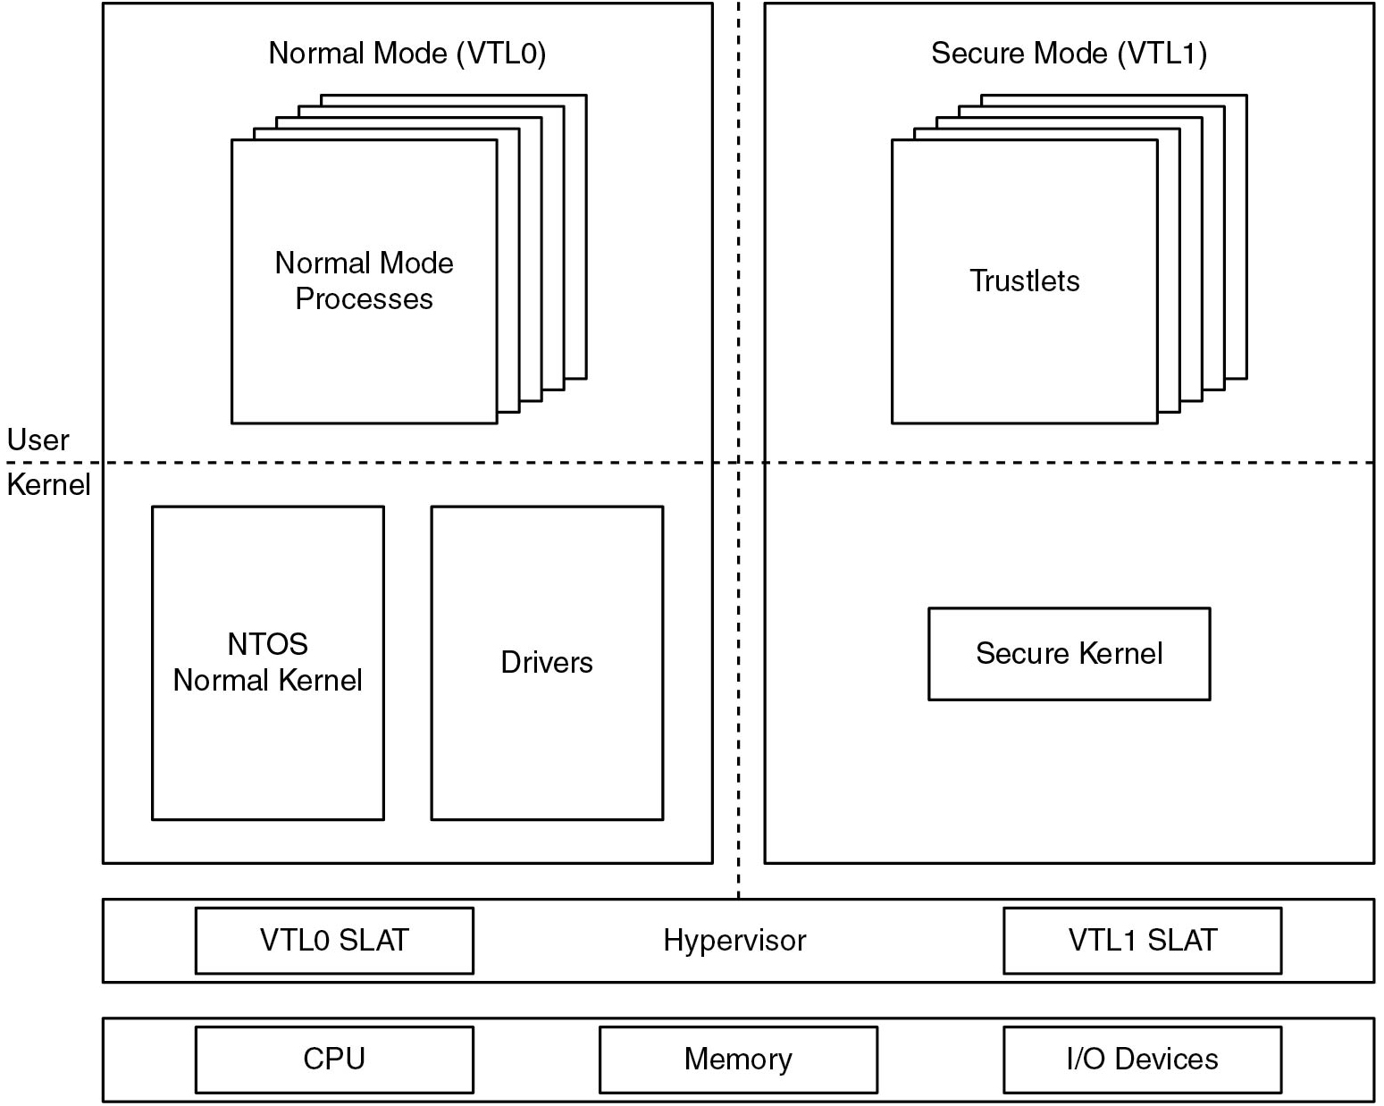
Virtual Secure Mode
Figure 11.54 Virtual Secure Mode architecture.
Notes:
Long Description:
The figure consists of two vertical blocks and two horizontal blocks. A horizontal dotted line is passing through the mid of these three vertical blocks which divides the blocks into two parts. The first vertical block is labeled Normal Mode (V T L 0), the upper part of the block is consist of one sub-block which is labeled Normal mode process and the lower part of the block is consist of two sub-blocks labeled N T O S Normal kernel and Drivers. The second vertical block is labeled Secure Mode (V T L 1), the upper part of the block is consist of one sub-block labeled Trustlets and the lower part of the block is consist of one sub-block labeled Secure Kernel. The horizontal block is labeled Hypervisor which is divided into two sub-blocks and labeled V T L 0 S L A and V T L 1 SLAT. Another horizontal block is divided into three sub-blocks which are labeled C P U, Memory, I bar O Devices.

Slide 58
Access Tokens
Figure 11.55 Structure of an access token.
Notes:
Long Description:
The figure shows a horizontal block that is divided into ten parts. The entries are as follows: Header, Expiration time, Groups, Default D A C L, User S I D, Group S I D, Restricted S I Ds, Privileges, Impersonation level, and Integrity level.

Slide 59
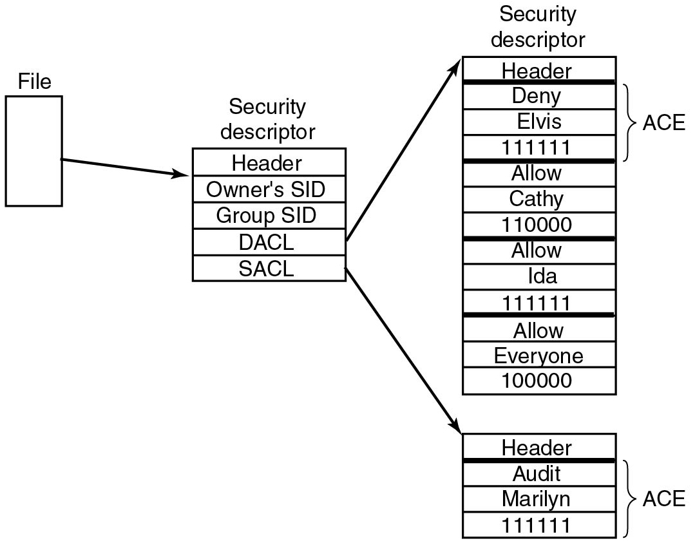
Security Descriptors
Figure 11.56 An example security descriptor for a file.
Notes:
Long Description:
The figure shows a rectangular block labeled File. This block is pointing an arrow toward the Security descriptor block which is divided into five rows. The row entries are as follows: Header, Owner's S I D, Group, S I D, D A C L, and S A C L. This block is pointing an arrow toward the Security descriptor block which is divided into five sub-blocks. The first block is labeled Header. The second block is A C E and is divided into three rows which are labeled Deny, Elvis, and 1 1 1 1 1 1. The third block is divided into three rows which are labeled Allow, Cathy, and 1 1 0 0 0 0. The fourth block is divided into three rows which are labeled Allow, Ida, and 1 1 1 1 1 1. The fifth block is divided into three rows which are labeled Allow, Everyone, and 1 0 0 0 0 0. The second block is pointing an arrow toward another rectangular block which is divided into two sub-block. The first block is labeled Header and the second block is divided into three rows which are labeled Audit, Marilyn, and 1 1 1 1 1 1 and also labeled A C E.

Slide 60
Win 32 Calls for Security
Win 32 A P I function | Description
Initialize Security Descriptor | Prepare a new security descriptor for use
Look up Account S i d | Look up the S I D for a given user name
Set Security Descriptor Owner | Enter the owner S I D in the security descriptor
Set Security Descriptor Group | Enter a group S I D in the security descriptor
Initialize A c l | Initialize a D A C L or S A C L
Add Access Allowed Ace | Add a new A C E to a D A C L or S A C L allowing access
Add Access Denied Ace | Add a new A C E to a D A C L or S A C L denying access
Delete Ace | Remove an A C E from a D A C L or S A C L
Set Security Descriptor D a c l | Attach a D A C L to a security descriptor
Figure 11.57 The principal Win 32 A P I functions for security.

Slide 61
Security Protection Mechanisms (1 of 2)
Mitigation | V B S-only | Description
Init All | No | Zero-initializes stack variables to avoid vulnerabilities
/G S | No | Add canary to stack frames to protect return addresses
D E P | No | Data Execution Prevention. Stacks and heaps are not executable
A S L R/K A S L R | No | Randomize user/kernel address space to make R O P attacks difficult
C F G | No | Control Flow Guard. Protect integrity of forward-edge control flow
K C F G | Yes | Kernel-mode C F G. Secure Kernel maintains C F G bit map
X F G | No | Extended Flow Guard. Much finer grained protection than C F G
C E T | No | Strong defense against R O P attacks using shadow stacks
Figure 11.58 Some of the principal security protections in Windows.

Slide 62
Security Protection Mechanisms (2 of 2)
Mitigation | V B S-only | Description
K C E T | Yes | Kernel-mode C E T. Secure Kernel maintains shadow stacks.
P A C | No | Protects stack return addresses using signatures
C I G | No | Enforces that code binaries are properly signed
A C G | No | User-mode enforcement for WˆX and that data cannot become code
H V C I | Yes | Kernel-mode enforcement for WˆX and that data cannot become code
Patch Guard | No | Detect attempts to modify kernel code and data
Hyper Guard | Yes | Stronger protection than Patch Guard
Windows Defender | No | Built-in antimalware software
Figure 11.58 Some of the principal security protections in Windows.(Continued)

Slide 63
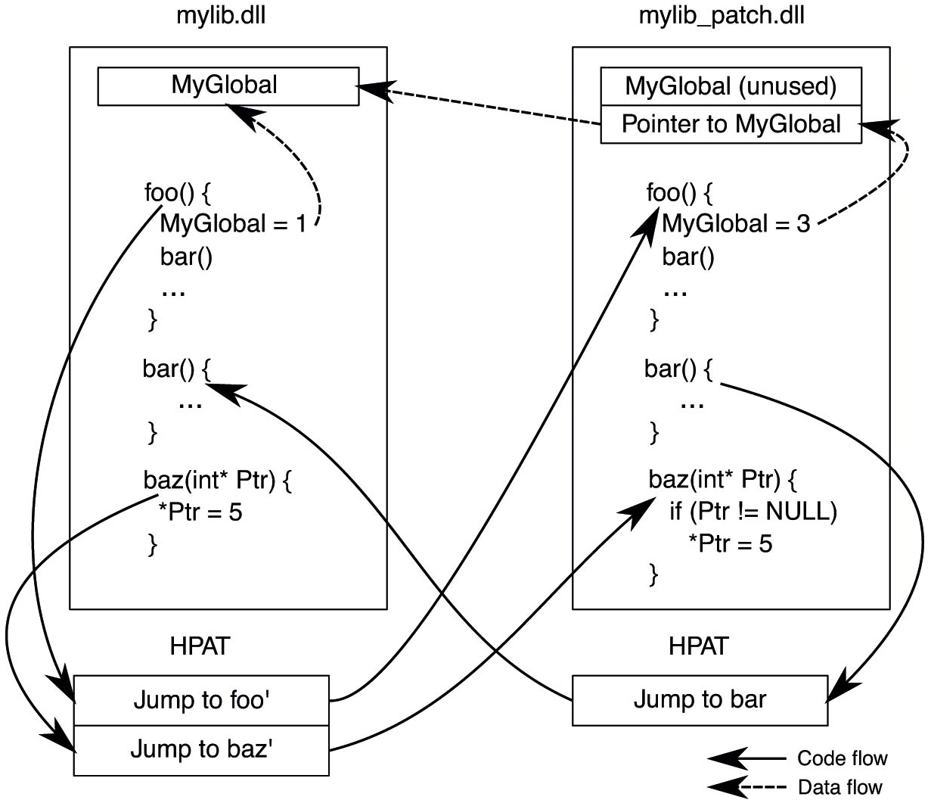
Hotpatching
Figure 11.59 Hot patch application for my lib.d l l. Functions foo( ) and Baz () are updated.
Notes:
Long Description:
The figure shows two rectangular vertical block. The first block is labeled my lib dot d l l and a sub block inside the block which is labeled My Global. The block illustrates code which is given as follows: foo() open curly bracket My Global equals 1 bar() close curly bracket bar() open curly bracket close curly bracket baz(int asterisk P t r) open curly bracket asterisk P t r equals 5 close curly bracket An arrow is pointing from the line My Global equals 1 to the sub block My Global. A two segmented block labeled H P A T is placed below the vertical block and labeled Jump to foo and Jump to baz and two arrows are pointed toward these segments. The second block is labeled my lib underscore patch.dll and two sub blocks inside the block which are labeled My Global(unused) and Pointer to My Global. The block illustrates code which is given as follows: foo() open curly bracket My Global equals 3 bar() close curly bracket bar() open curly bracket close curly bracket baz(int asterisk P t r) open curly bracket if(P t r exclamation equals NULL) asterisk P t r equals 5 close curly bracket An arrow is pointing from the line My Global equals 1 to the sub block My Global. A block labeled H PAT is placed below the vertical block and labeled Jump to bar. An arrow is pointing from the line bar() open curly bracket to the jump to bar block. A dotted arrow is pointing from the My Global equals 3 to Pointer to My Global sub block and other dotted arrow is ponted to the My Global sub block of the first vertical column. The dotted arrow is labeled data flow and darked arrow is labeled code flow.

Slide 64

Copyright
This work is protected by United States copyright laws and is provided solely for the use of instructors in teaching their courses and assessing student learning. Dissemination or sale of any part of this work (including on the World Wide Web) will destroy the integrity of the work and is not permitted. The work and materials from it should never be made available to students except by instructors using the accompanying text in their classes. All recipients of this work are expected to abide by these restrictions and to honor the intended pedagogical purposes and the needs of other instructors who rely on these materials.

